Slide 1


Slide 2

DIGITAL FIRST CUSTOMER SERVICE
Eengaging at the right moment, in the most efficient and relevant way, seen to and directly as a part of the customers digital context

Slide 3

>60% of the customers that call* Customer Service started their journey in a digital interface
>40% are still on-line during the call
Why force customers out of their digital context?
*Source CEB ”The effortless experience”. If channels like e-mail and chat are included the percentage is much higher
VARFÖR TVINGA KUNDER TILL TELEFON?
Notes:
Source :CEB ”The effortless experience”

Slide 4
“Digital First Customer Service Solutions emerge as their own software category”*
*Forrester Research Jun20

Slide 5
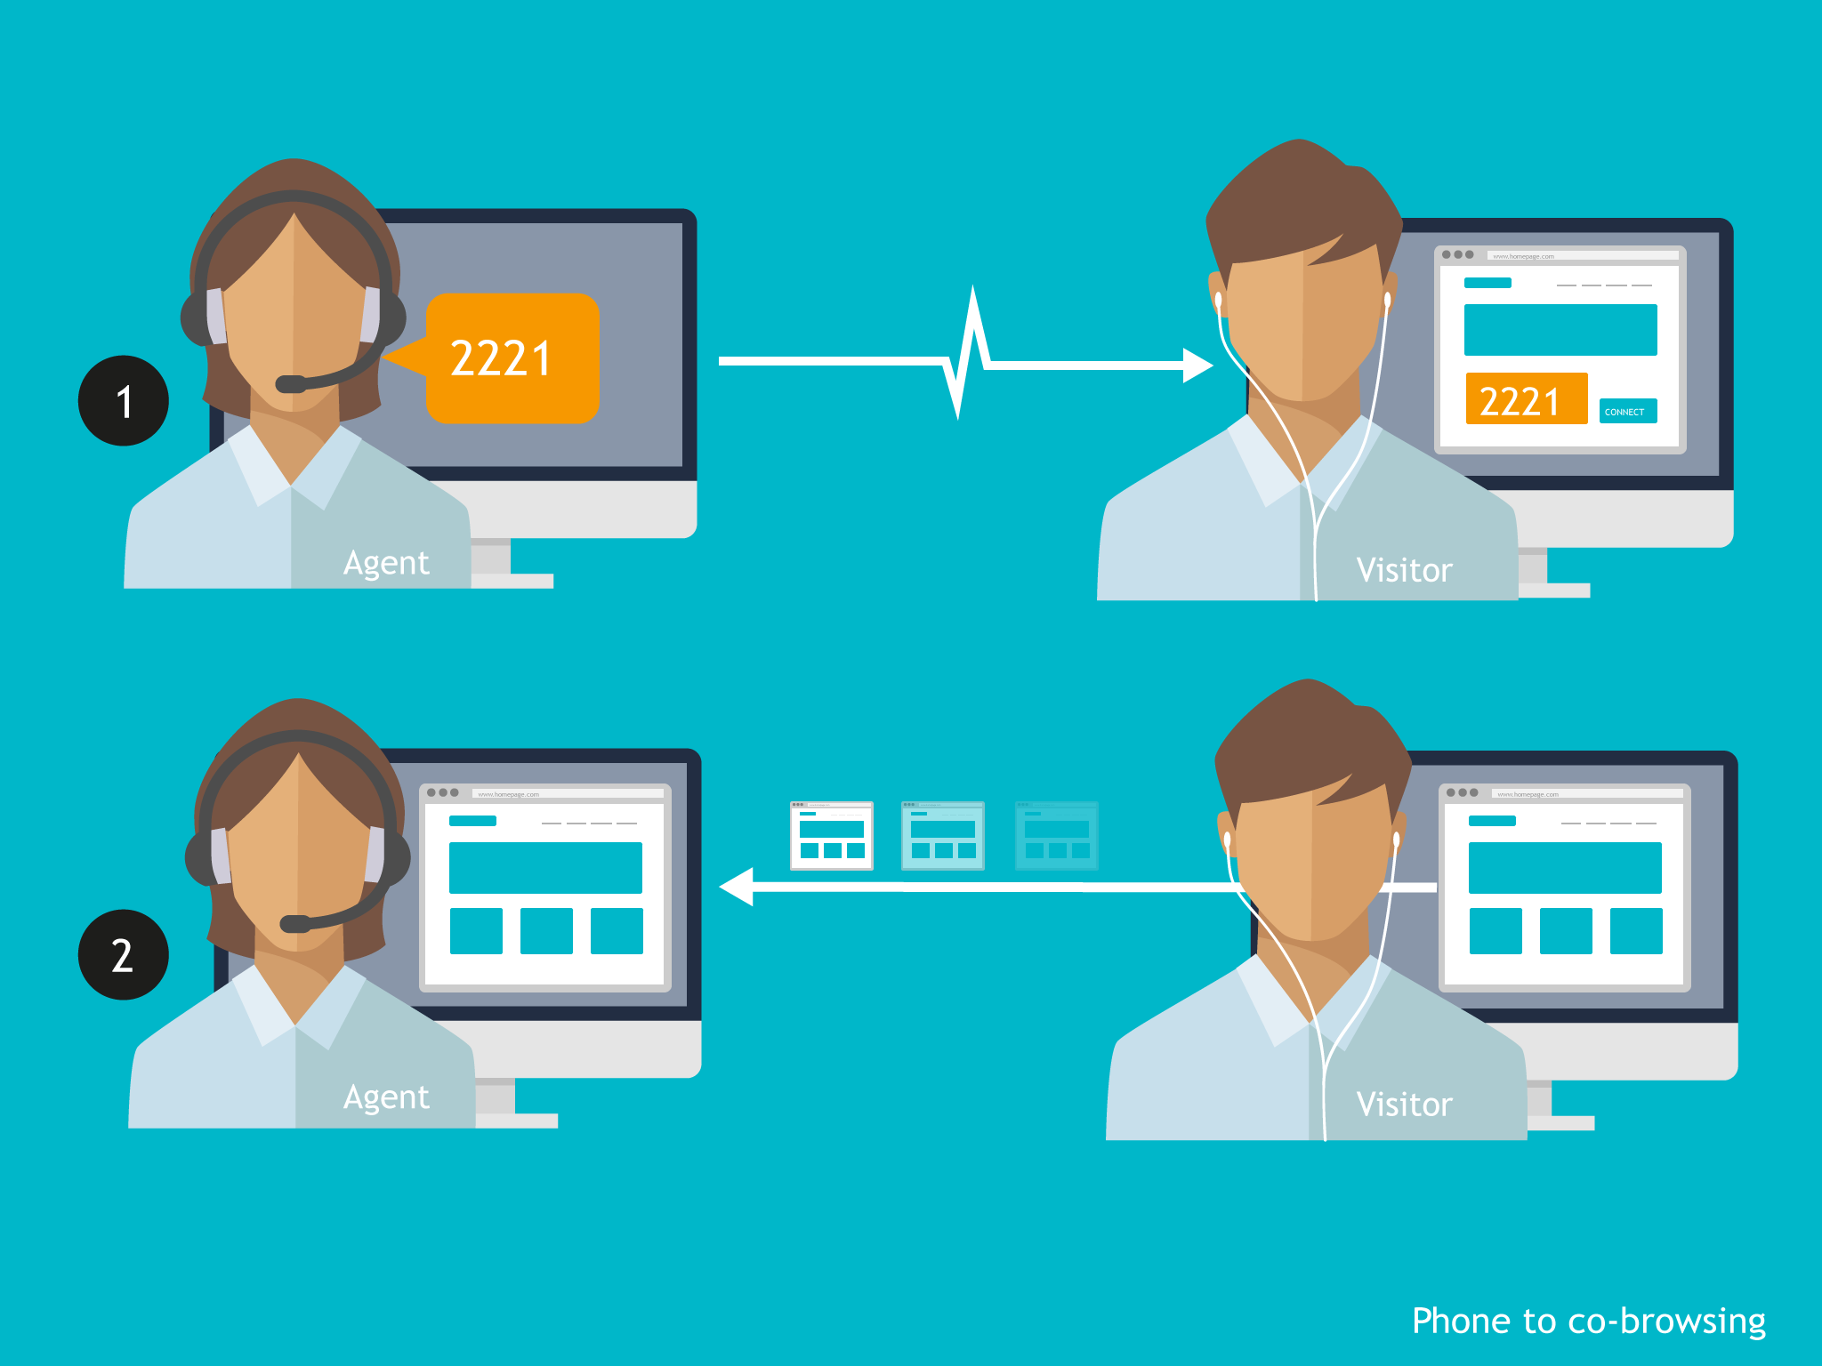
Phone2digital
Convert phone calls to, or support them with digital interaction
Easily connect a parallel online web session using the Vergic co-browsing feature, for convenient and efficient online assistance, in parallel with any ongoing phone conversation

Slide 6
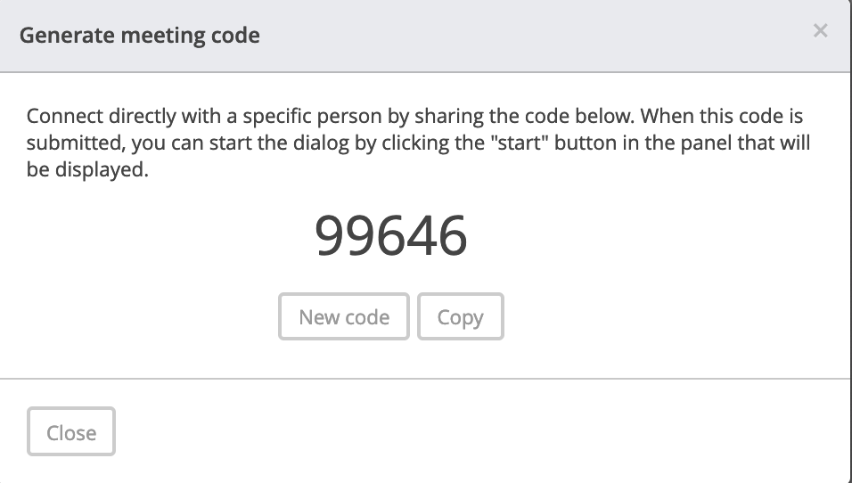
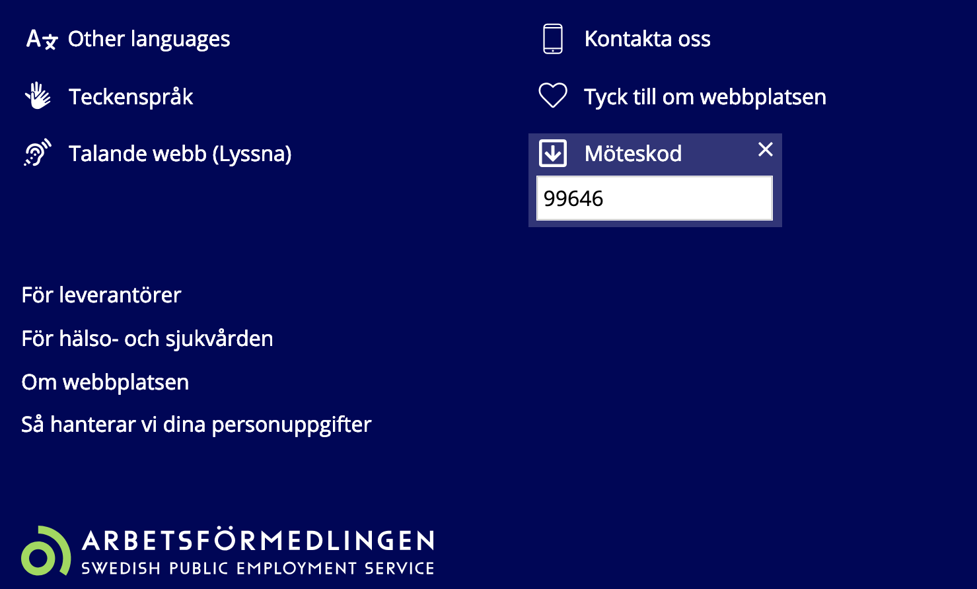

Slide 7
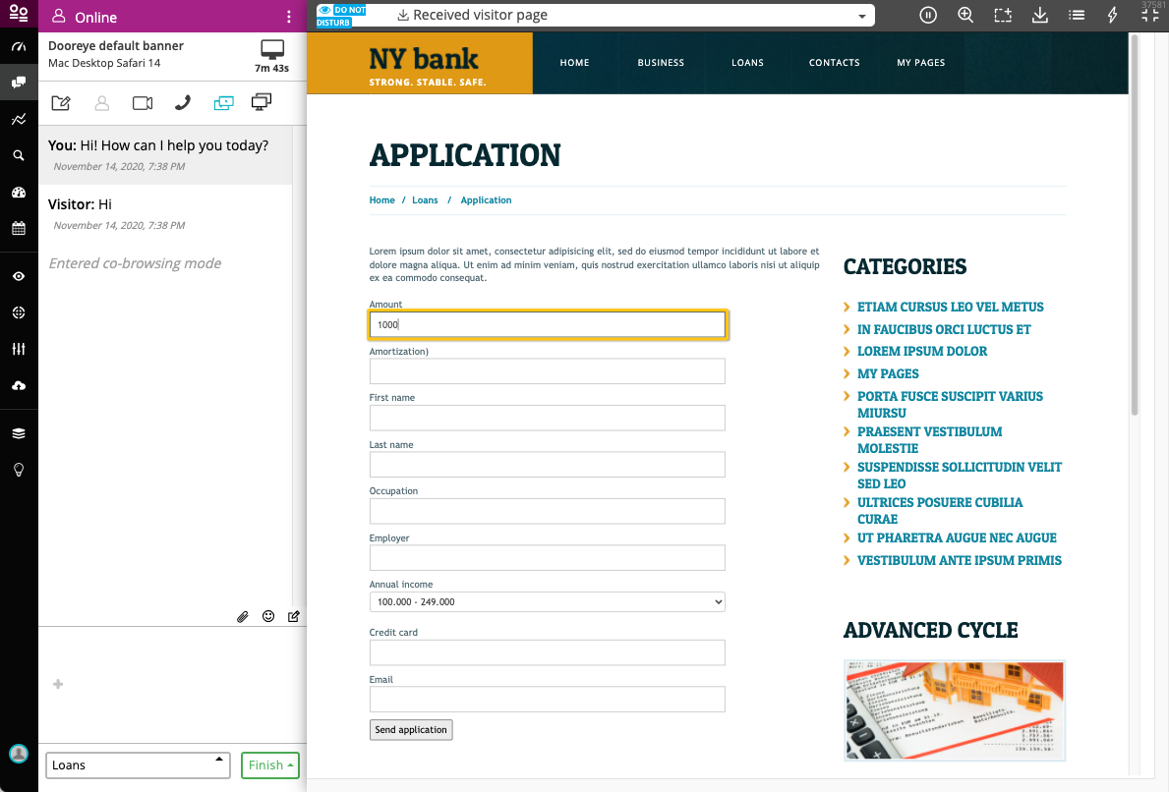
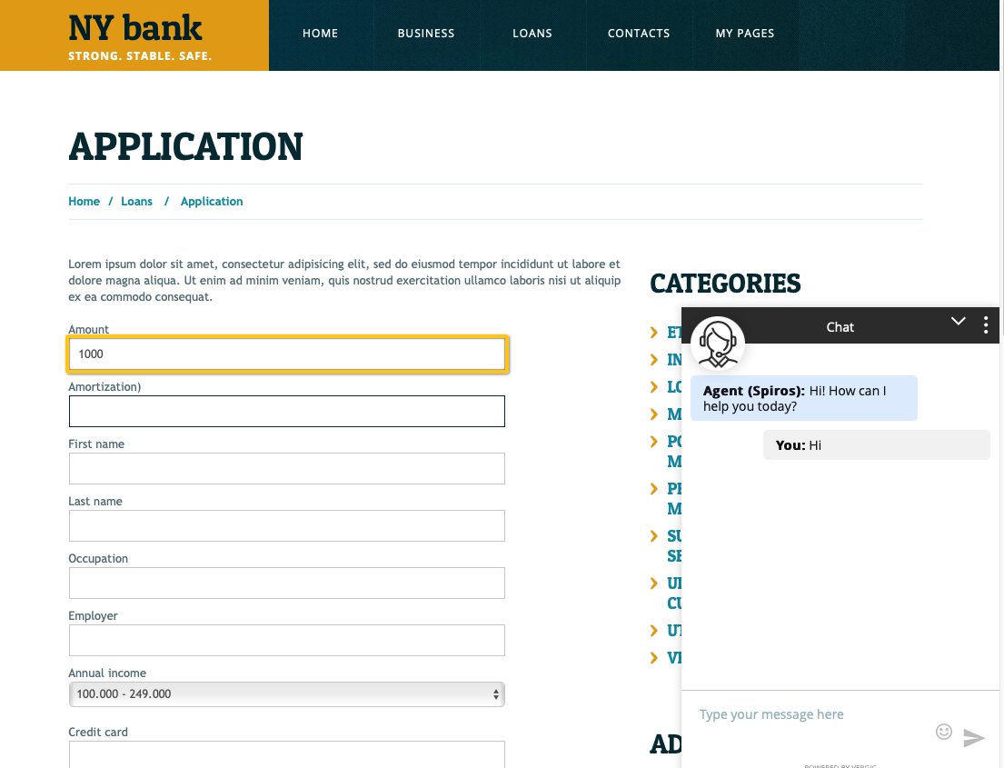
Chat and collaborate with your customers directly as a part of theire digital context, using Vergic Engage CoBrowsing features (browser plugin free)
Agent can sees the customers view, including customer input and in the same format as on the customers device, e.g. mobile device
Highlight and navigate
Let same agent chat and collaborate with multiple customers simultaniously
Help filling out forms / submit applications
Share content

Slide 8
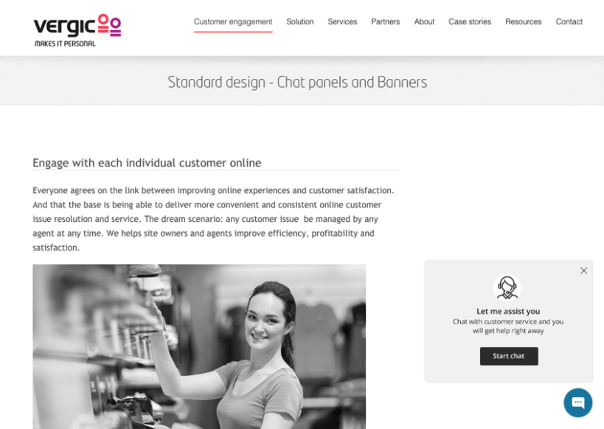
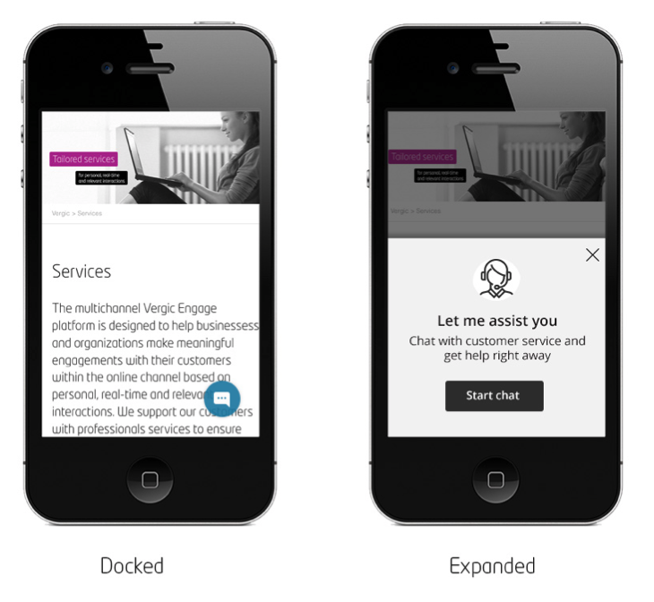
Customizable banner for chat requests
Control where on the site you want to offer chat

Slide 9
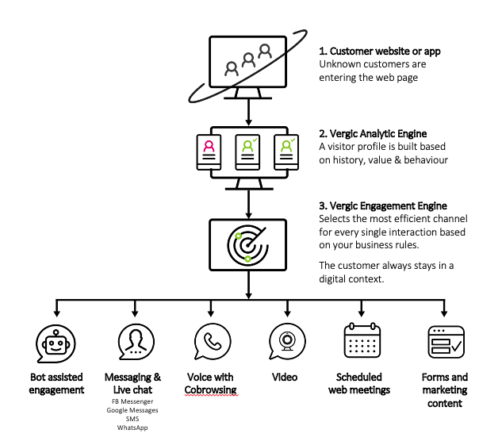
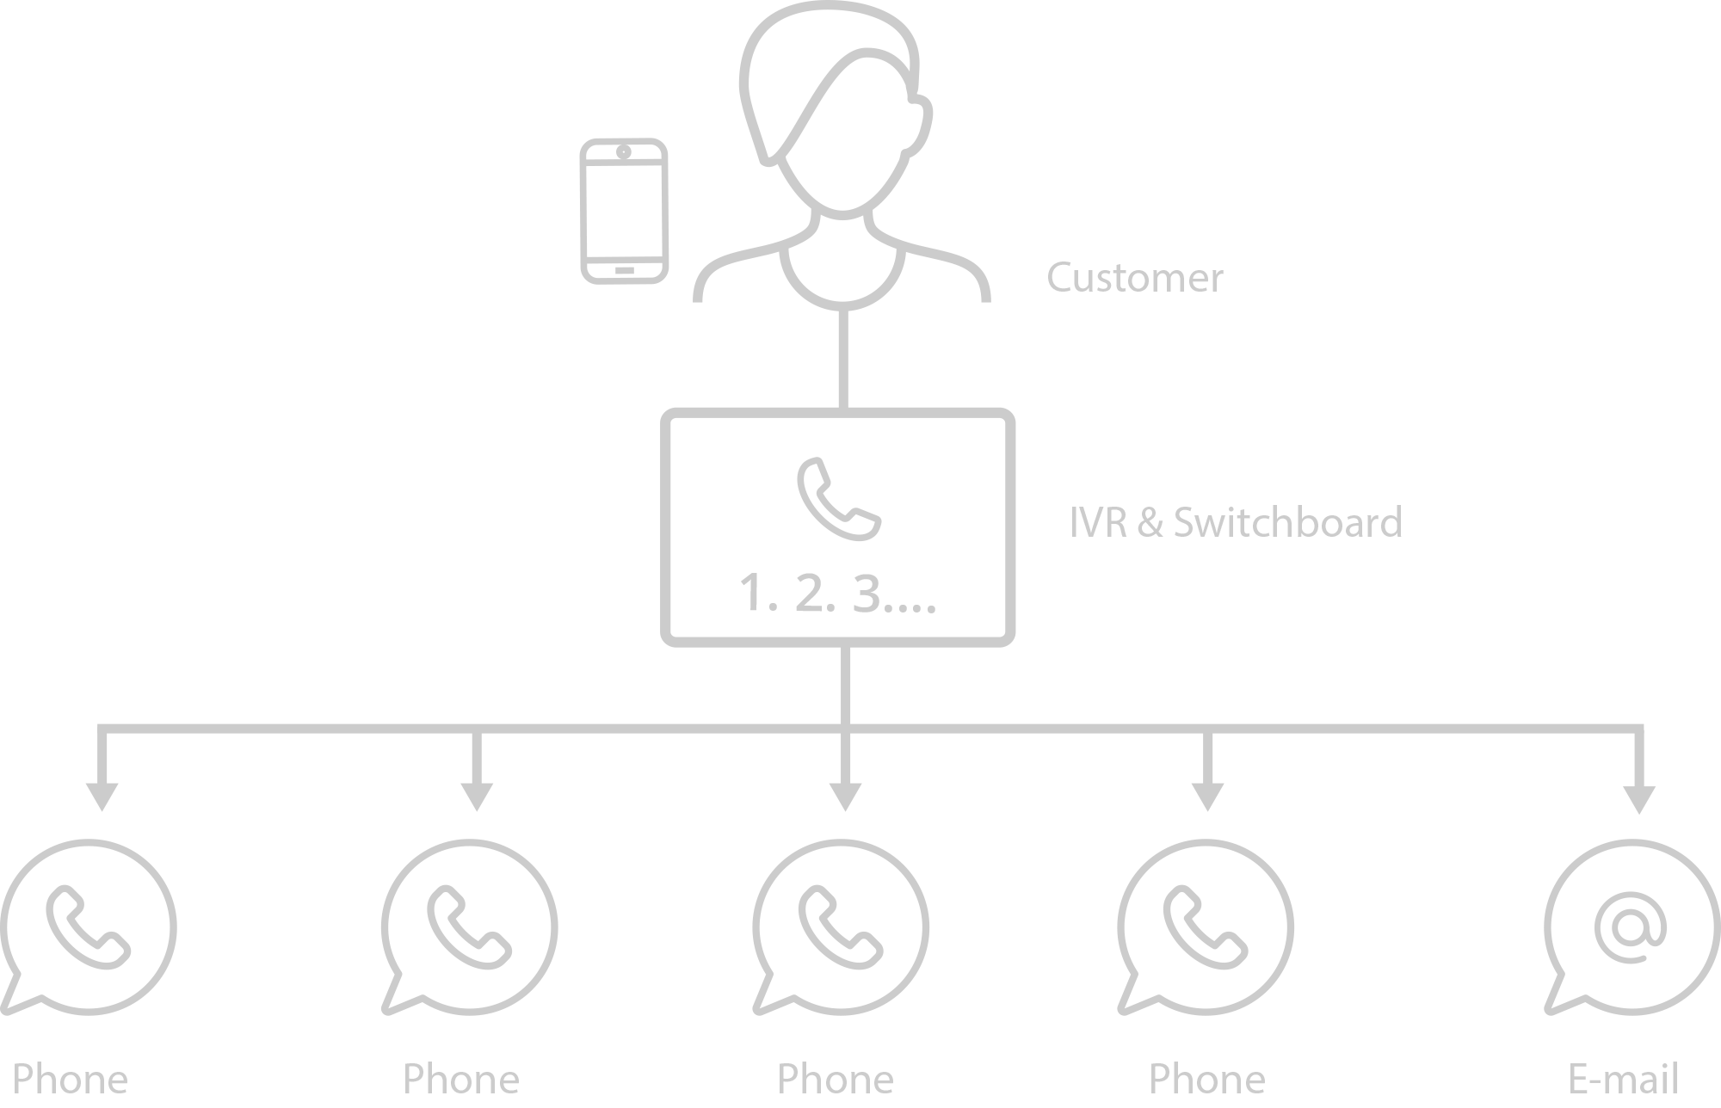

Slide 10
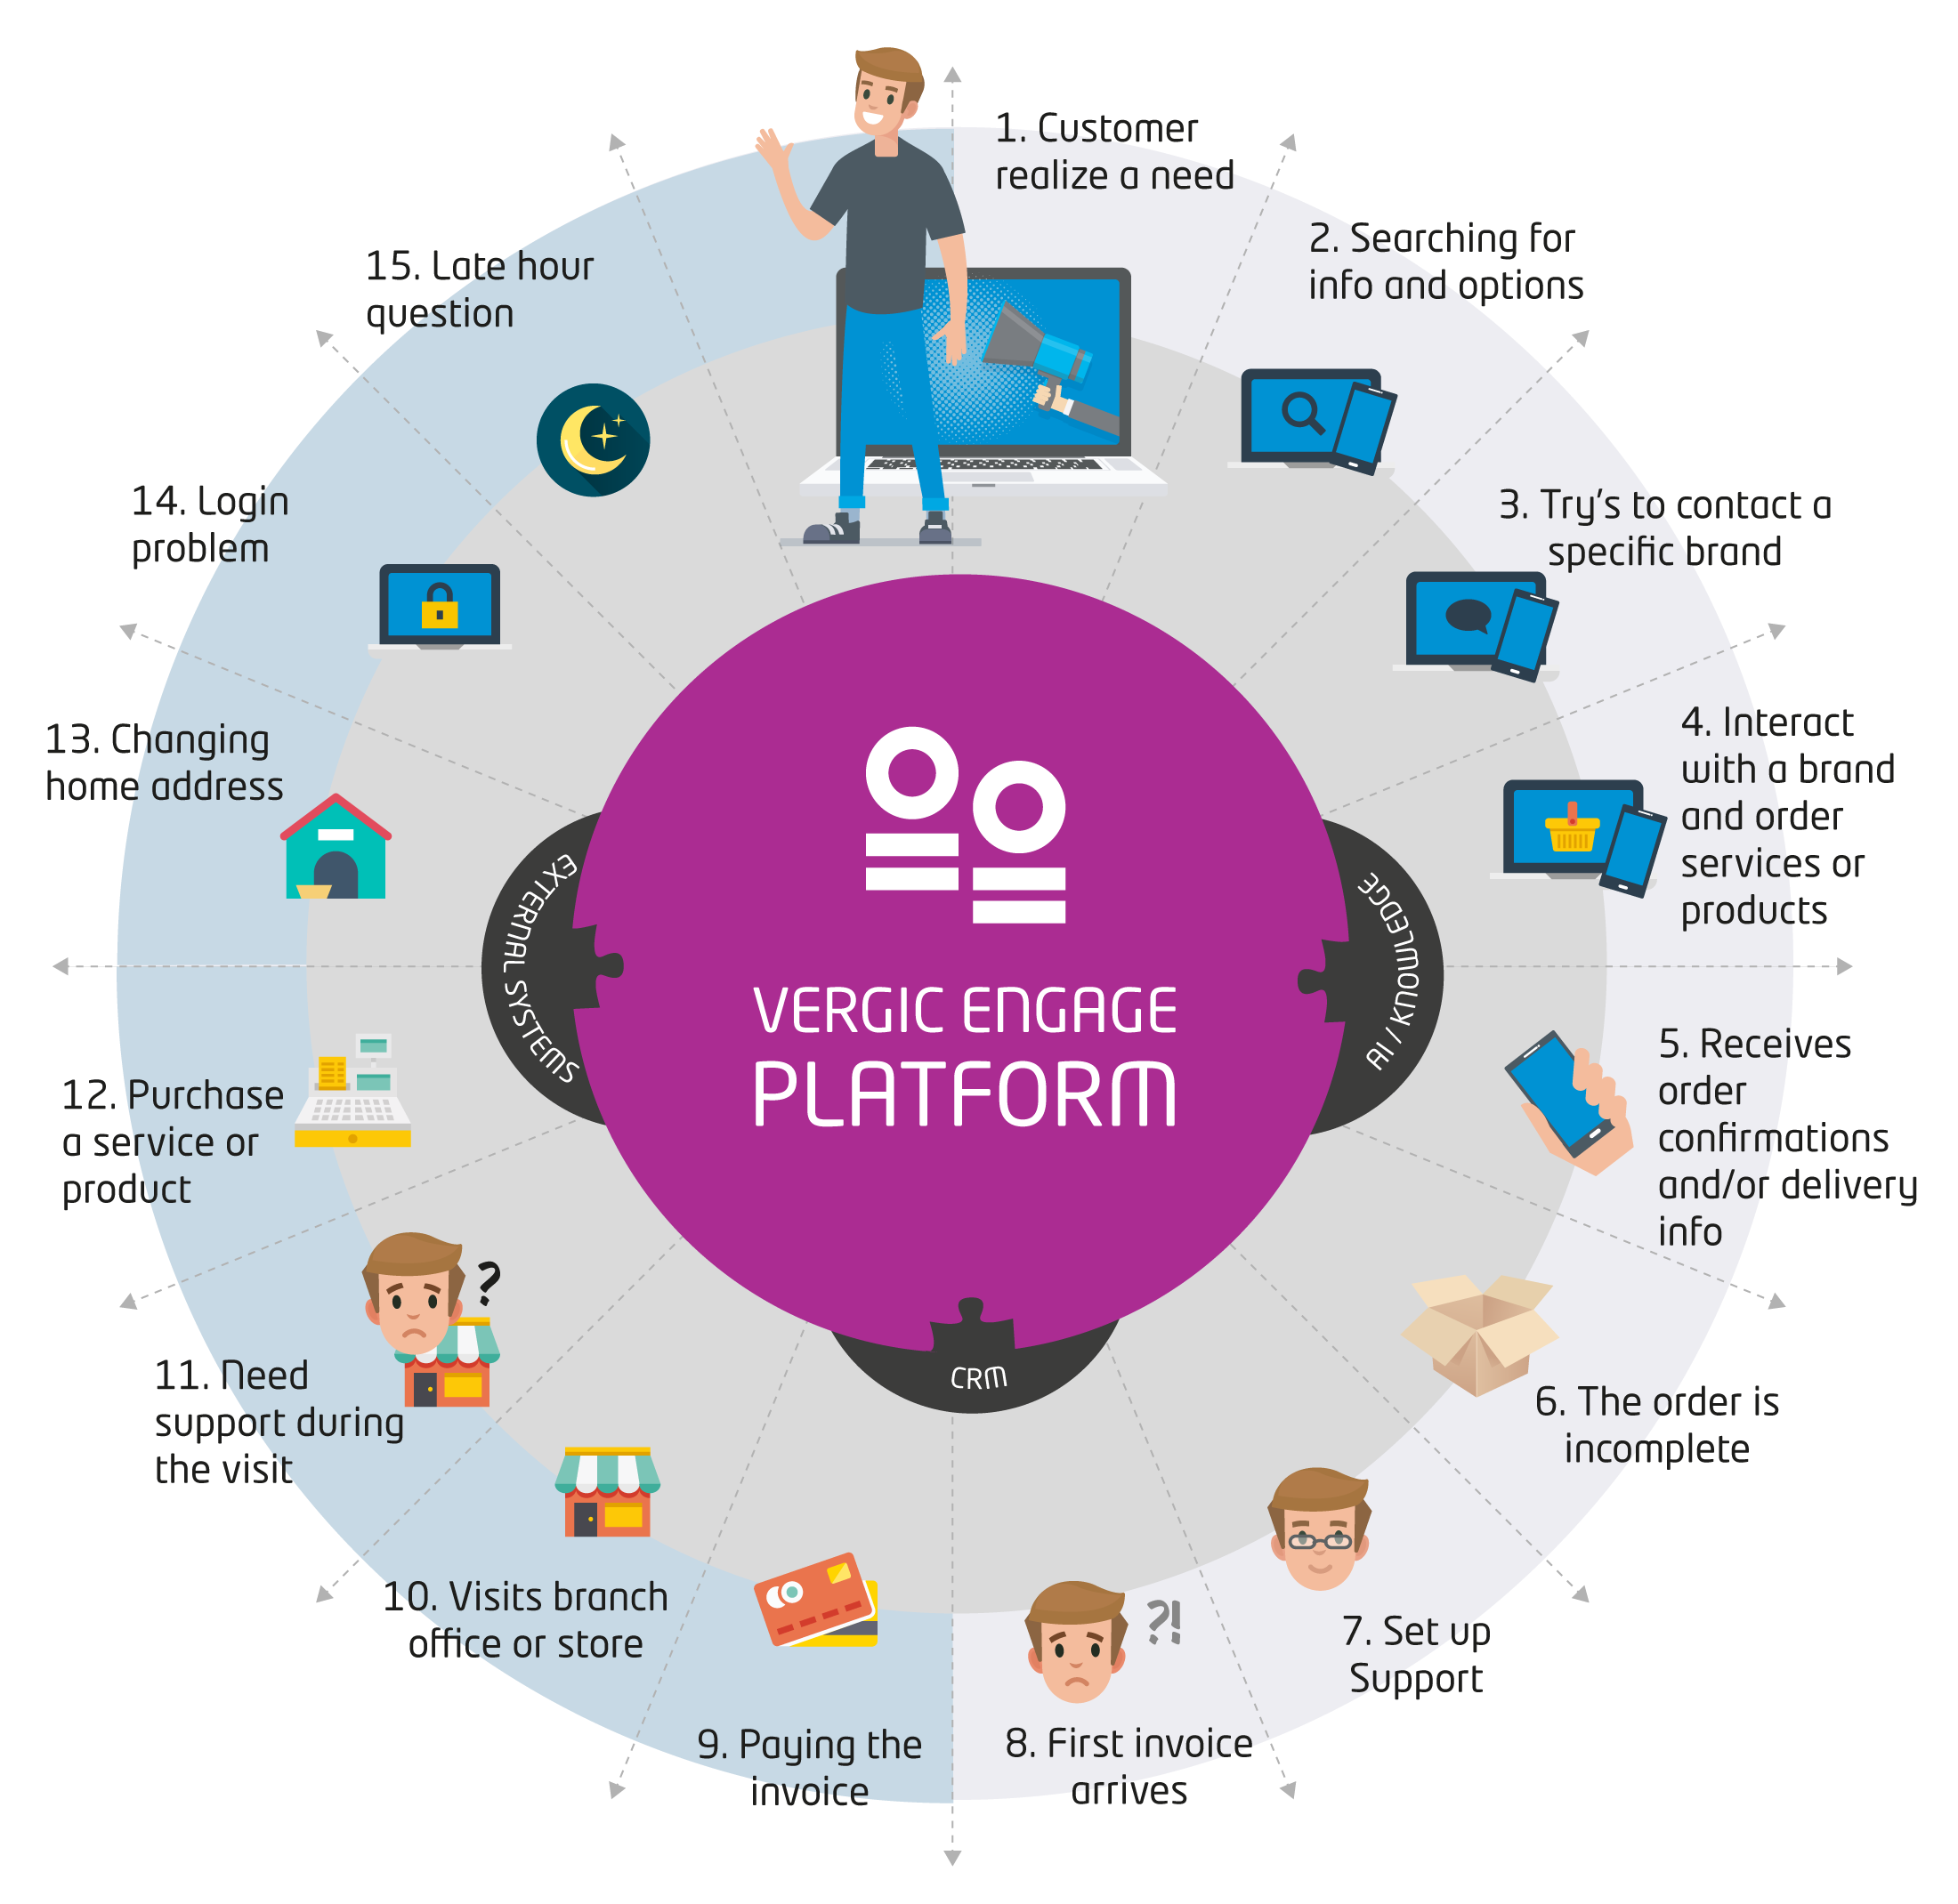

Slide 11
Pre-processing; building a visitor profile on-line
Voice call
Pre-booked digital meetings
Web visit
Lead generation
Digital process
Landing page
Chat
Marketing content or forms
BOT-assisted engagement
ERP
Analytics
CRM
Case M.g.n. Etc.

Slide 12
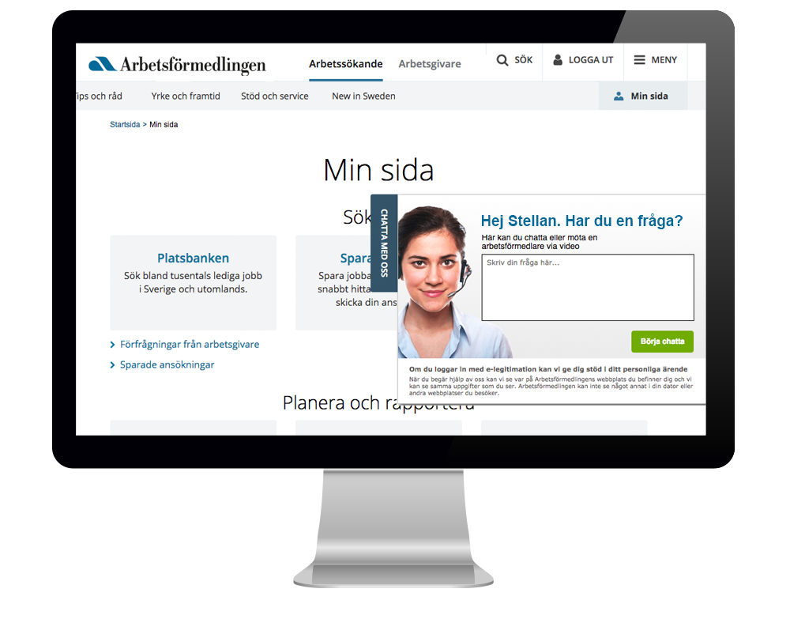
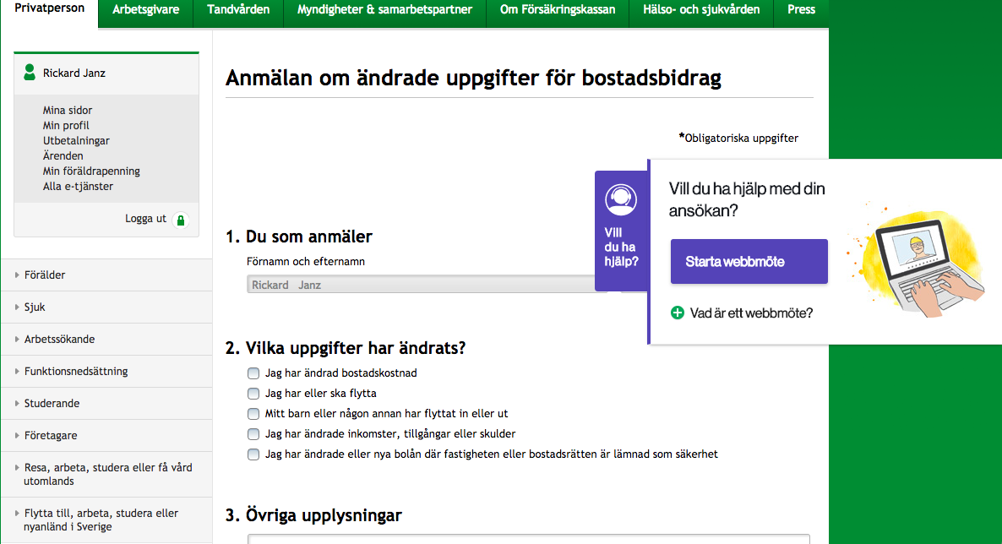
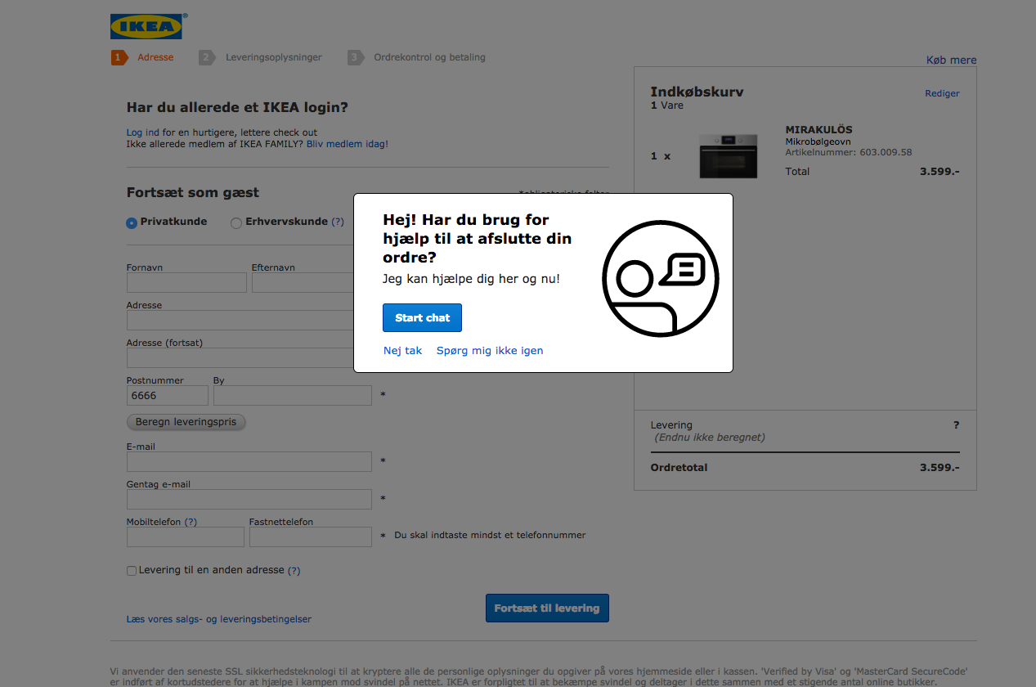
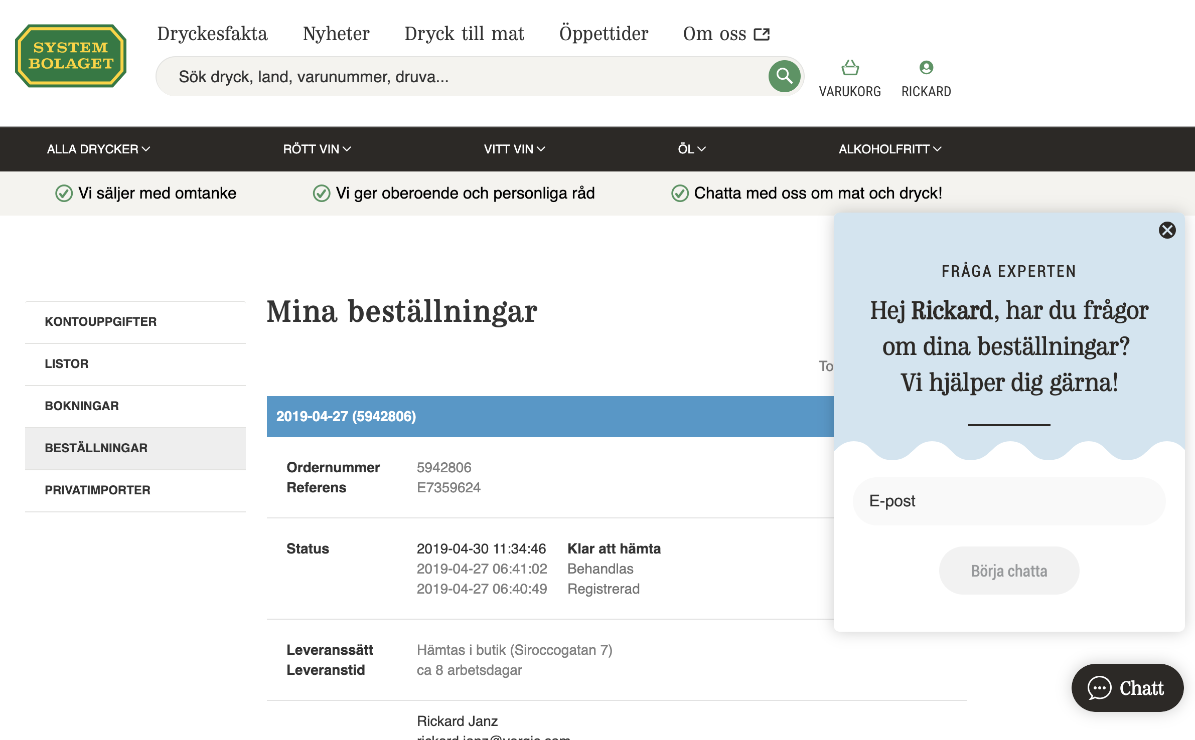
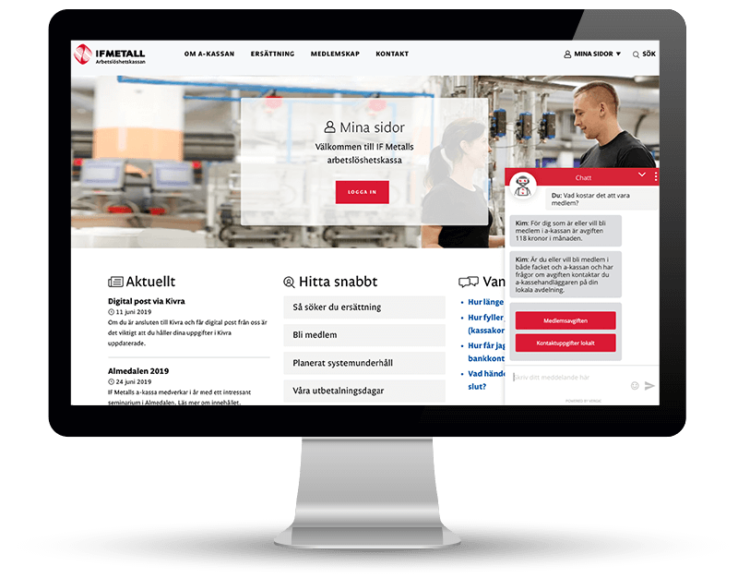
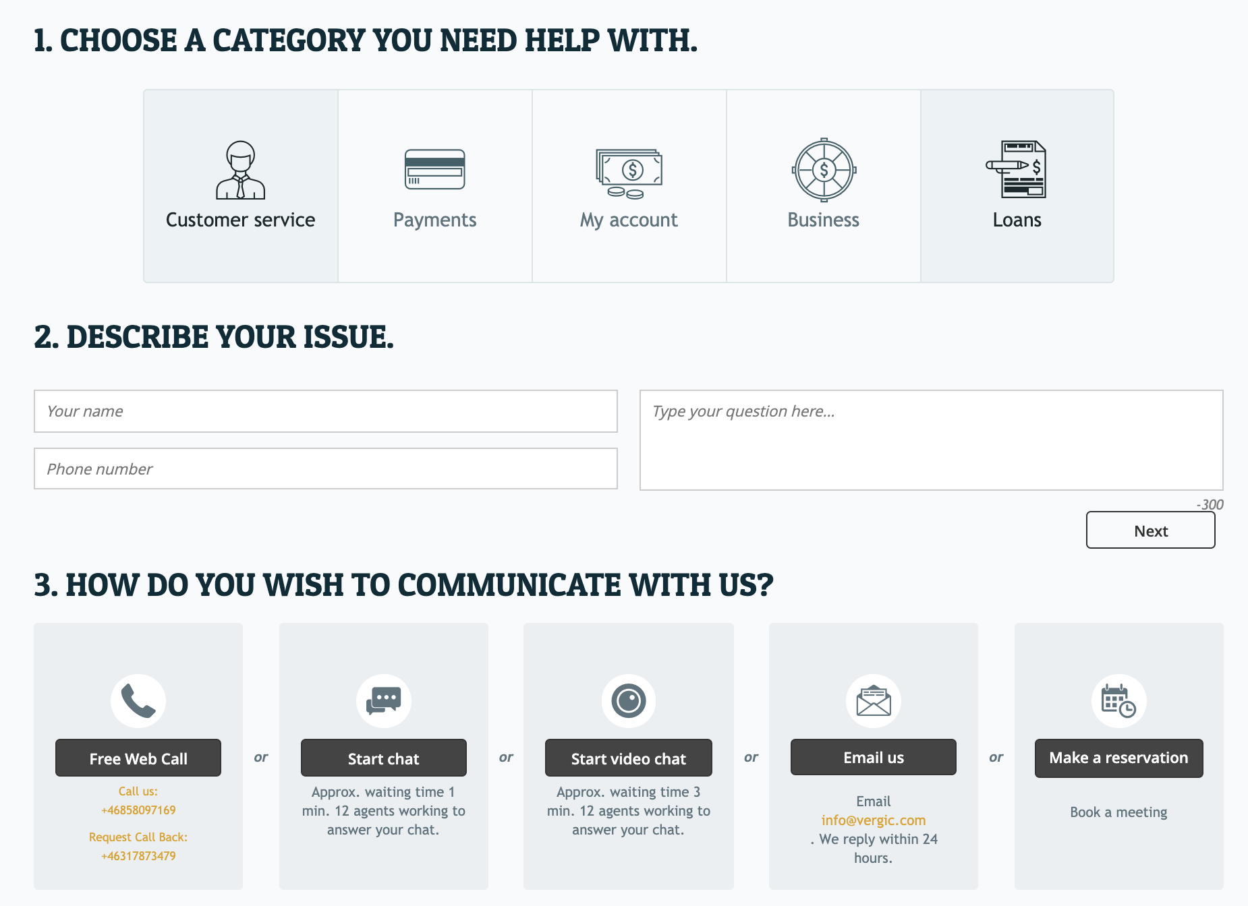
BOT has assisted through log-in, picked up customer id and continues process
Engage with the customer;
At the right moment
In the relevant digital context
In the preferred/most efficient channel
Relevant, proactive, contextual and efficient digital engagement
”Hi, do you need help to finish your order….
Notes:
Alternativ med e-commerce (IKEA) för kunder med det intresset

Slide 13
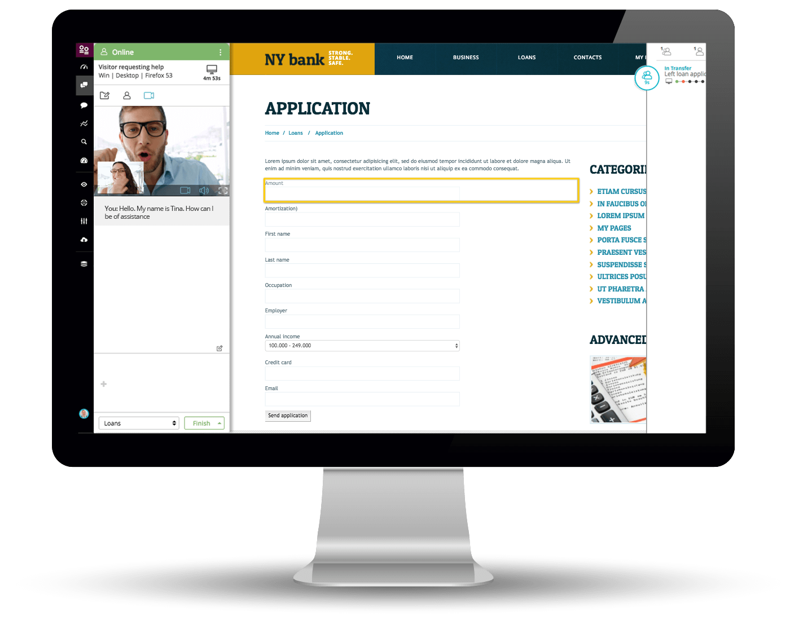
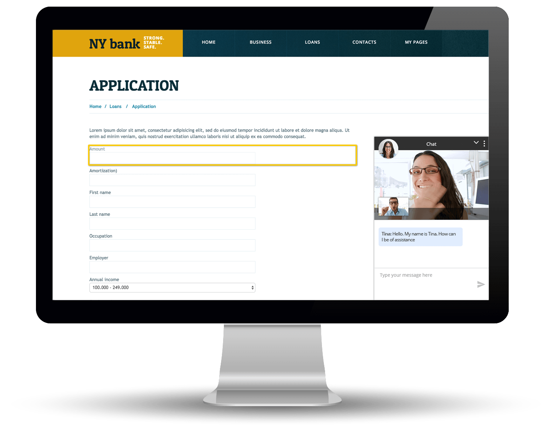
Multichannel and support for addons
Communicate via multiple multiple channels, parallelly and/or switch between, such as:
  Text chat
  Voice
  Video
  External channels, e.g. asynchronous chat (add on)
Share sensitive personal information
  Authentication services support
Supports addons such as
  Book-a-meeting
  Asynchronyouse messaging
  Automation / BOT

Slide 14

Vergic Engage BOT
& Automation concept
Automate dialogs and empower your agents

Slide 15
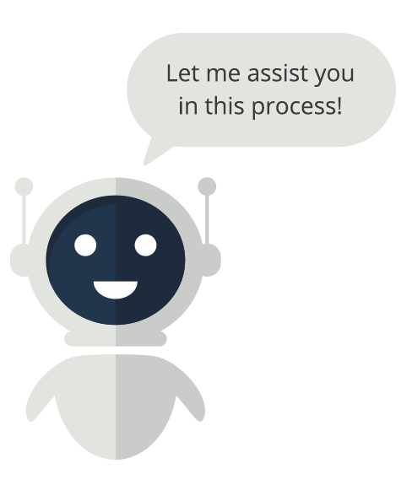
Where to use BOT …
Bot services generates most value supporting processes, i.e., “assist me with my…”
  A chat bot for answering general inquiries,
    Redundant information
    Expensive
    Content can’t be indexed
    Not a good format for presenting large amount of information
    There are other solutions proven to be much better at it

Slide 16
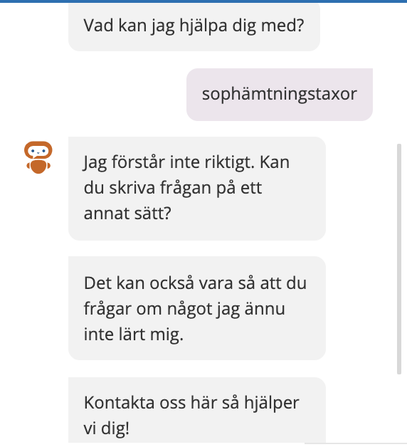
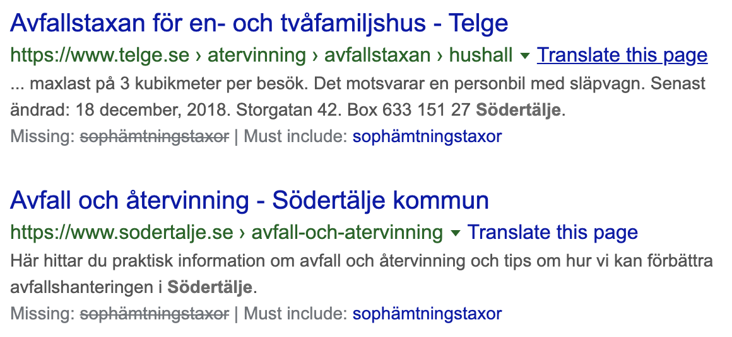
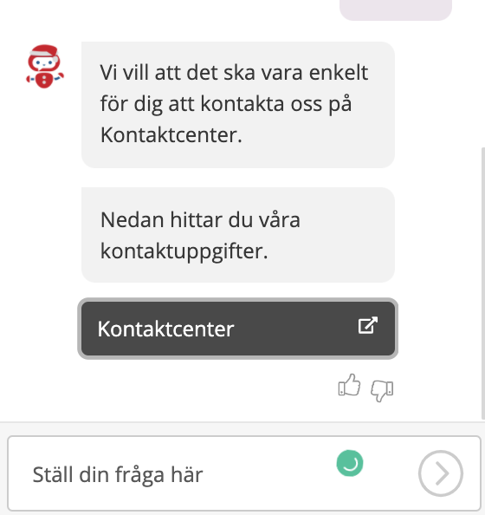
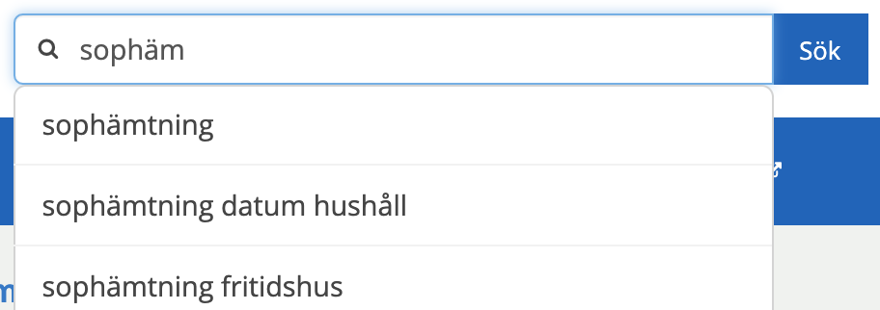
Exempel informationsöverlapp
Fråga till bot på samma webbplats ”sophämtningstaxor”
Webbsök ”Sophämtningstaxa xx kommun”
Chatbots
Web/CMS
Webbplatssök ”Sophäm” (redan där ger intern sökmotor träff)
Notes:
En förutsättning för att kunna möta kunden på ett relevant och sätt, direkt på webben, I en e-tjänst, webbprocess etc. och allra helst automatiserat är information. Rätt information vid rätt tillfälle vilket är det Ulf nu ska prata om

Slide 17

BOT automation
Efficient use of BOT technology for personal service automation
Control when, where
Powerful tools for process automation
NLU / intent management
A BOT is implemented as an agent, i.e. transfers are seamless and the BOT has access to the same powerful collaborative tools as any agent
Utilize Bot to train and/or support the agent

Slide 18
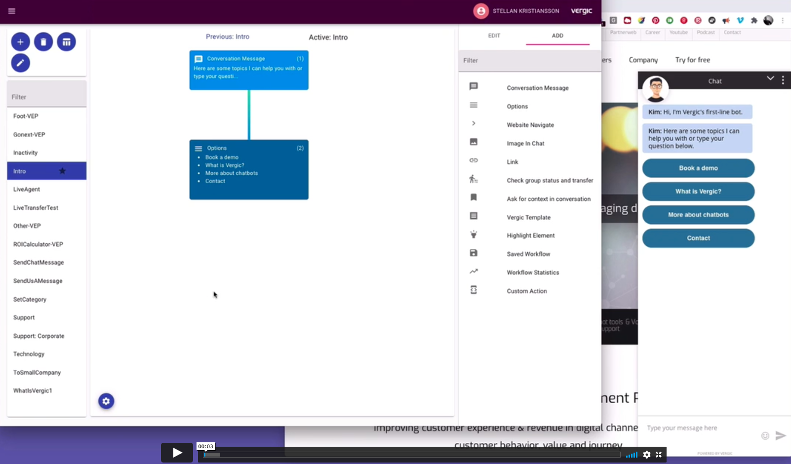
Drag and drop automation builder tool

Slide 19
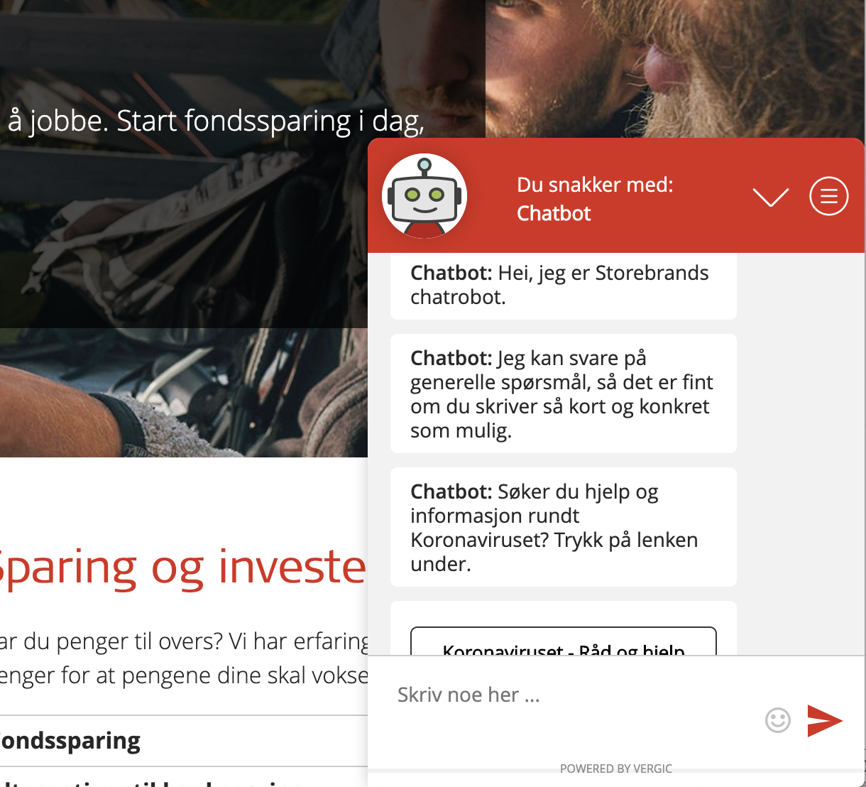
Based on customer context
Helps customer login before handing over
Seamless handover
BOT as first line
Notes:
bots & automation

Slide 20
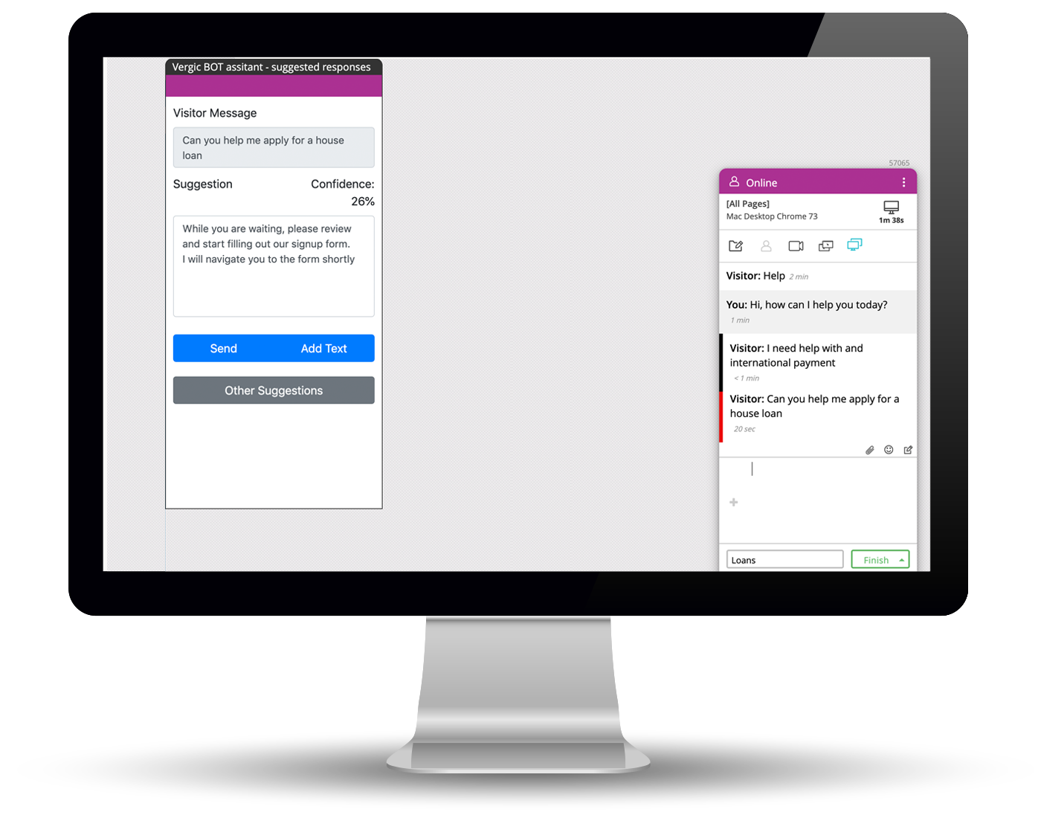
BOT/agent assistance - Suggested responses - Translation
AI/Bot service that listens in on an ongoing dialog and suggests answers to the agent (not visible to customer unless the agent decides to forward)
AI/Bot translates customer input and agent response back to customer

Slide 21

Qualified expert meetings online
Pre booked Digital meeting through Vergic Book-a-Meeting concept

Slide 22
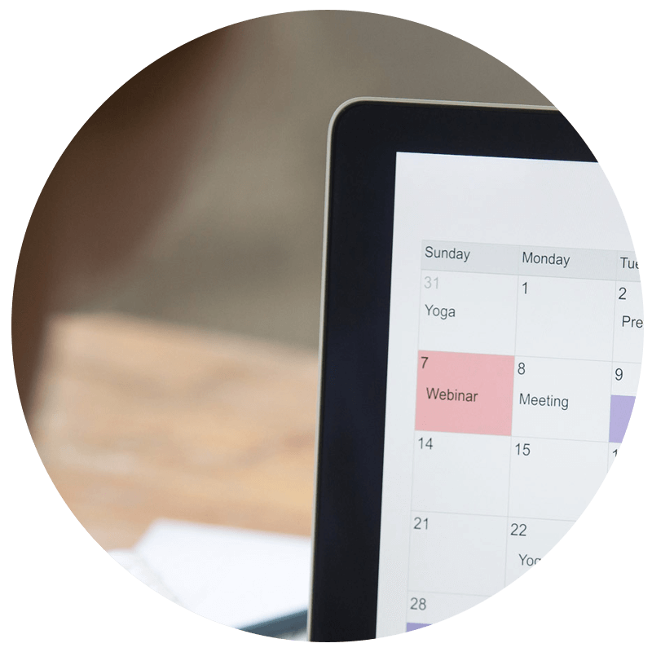
Pre booked online meetings
Utilize scheduling and resource management feature to let customer
book online meetings directly from within existing web services
Efficient use of qualified domain experts or sales reps
Replace physical meetings
End to end solution
  Book
  Confirm
  Connect
  Carry out utilizing advanced collabo

Slide 23
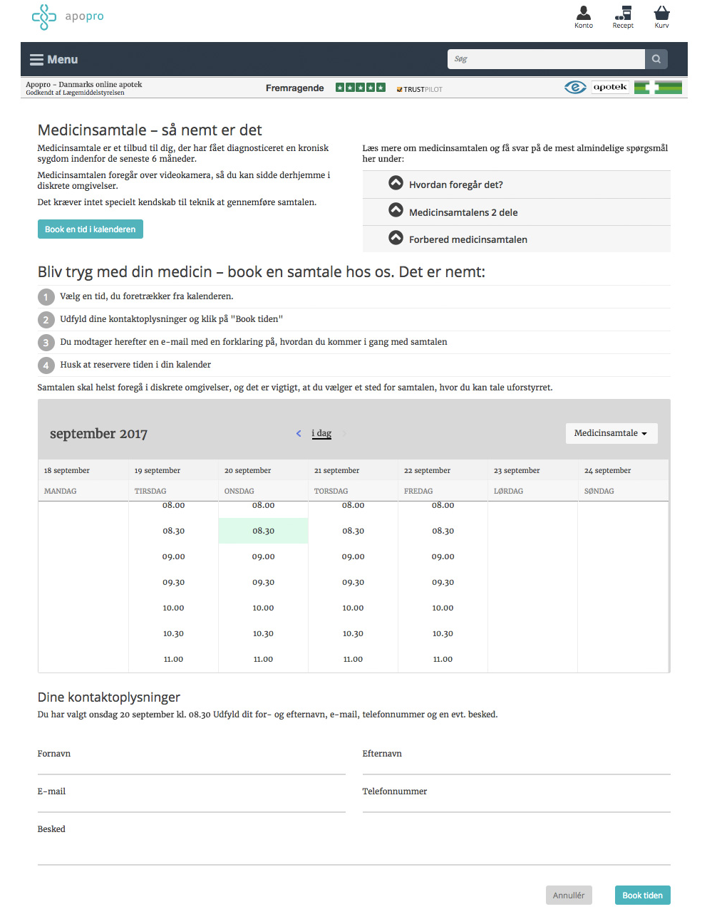
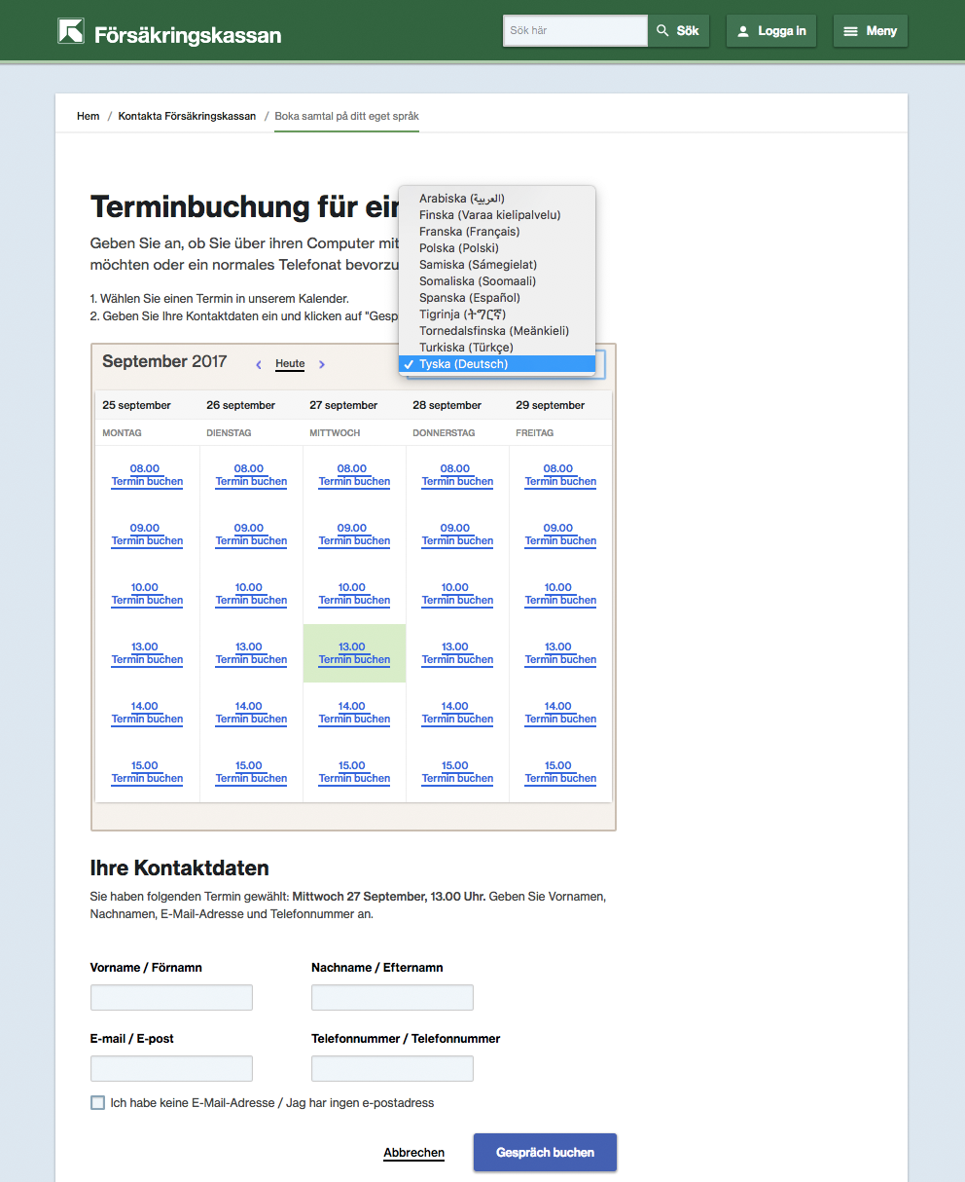
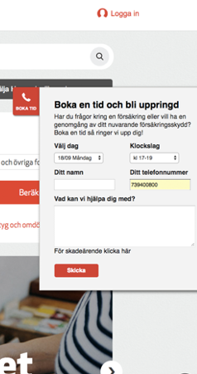
Egagement examples

Slide 24
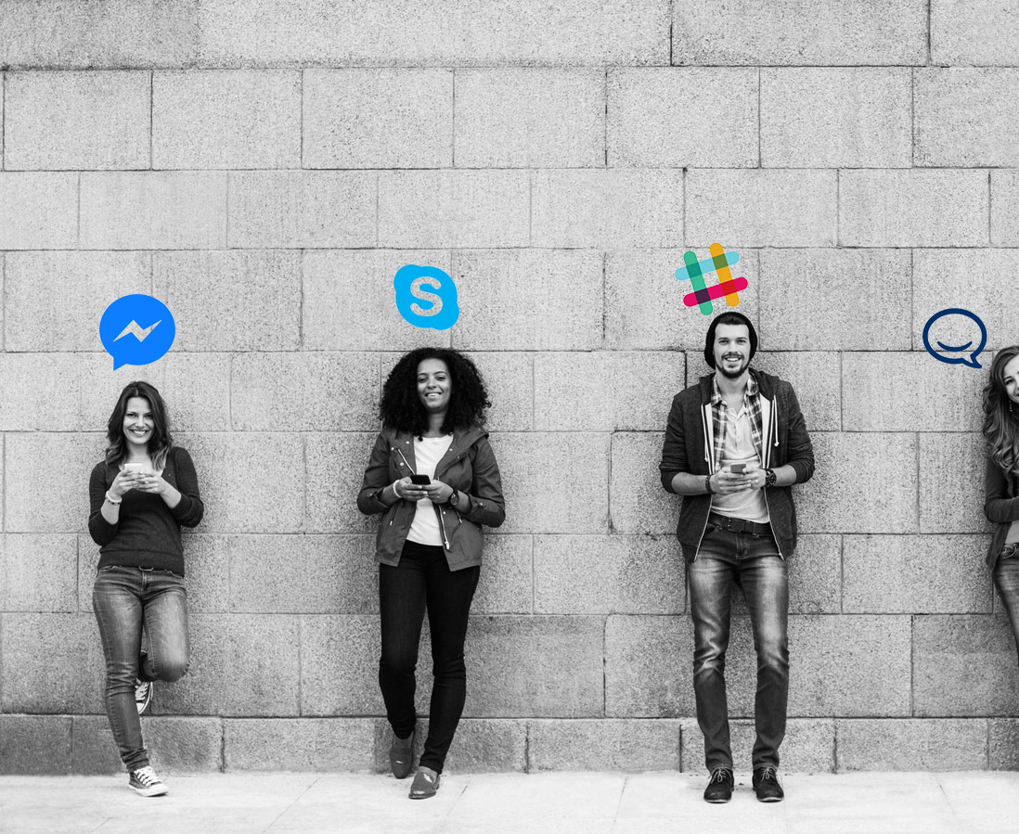
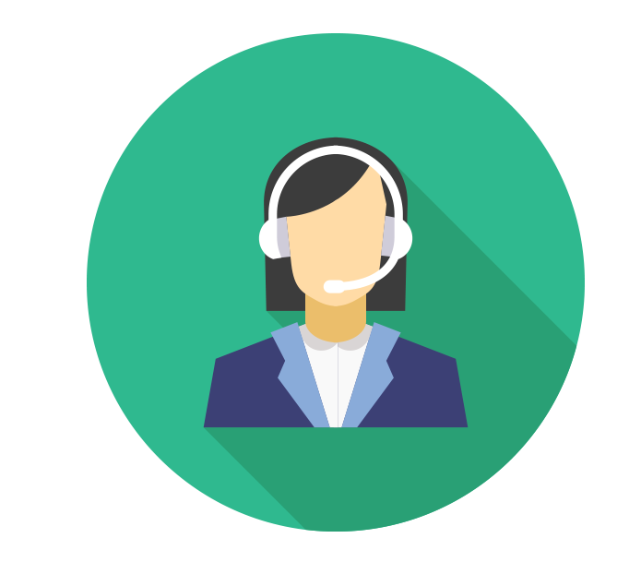
Asynchronous messaging
Handle multiple external messaging channels via one agent/user interface
Vergic Engage

Slide 25
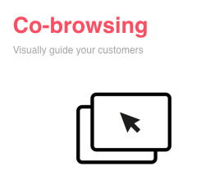
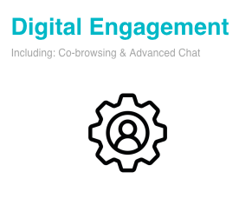
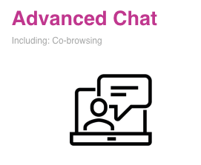
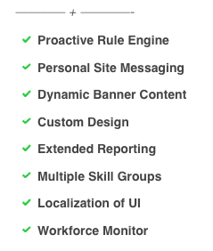
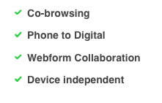
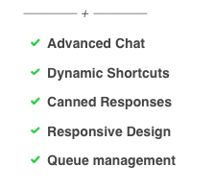





Slide 26
Addons …
Automation framework | Vergic Native BOT (NLU) | Book-a-meeting | Asynchronous messaging
€450 / month Including up to 5000 interactions/month and internal or external test,dev. and prod. BOT | €450 / month | €450 / month Including one (1) calender €150/additional calendar and month | €450 / month Including one messaging channel €150 / additional messaging channel and month

