Slide 1


Digital lead generation tool
Let your customer book a meeting with your experts on your web site. Don’t miss out any opportunity.

Slide 2

What is 'Digital lead generation tool’
The lead generation tool offers customers on your web site to book a online meeting with a sales reps, service agent or expert.
In the meeting the sales reps can communicate trough video or chat and together co-browse web pages and share documents.
The tool can deflect contacts on buzzy or closed hours without loosing the lead by offer a meeting slot on a better time
The meeting request can either be:
  Managed by Vergic’s calendar module to present and book available time slots and resources or…
  Sent to external booking system

Slide 3
What does 'Digital lead generation tool' solve for you
Don't miss out a lead if your sales reps/agents are:
  Buzzy or unavailable
  The right competence is not available in that moment
  Outside opening hours
Workforce optimization:
  Distribute contacts to periods where your sales reps/agents have less workload
Meet customers on their terms
  Let the customer select time and place that works the best for them
Suitable for more complex sales processes that requires more than a simple chat

Slide 4

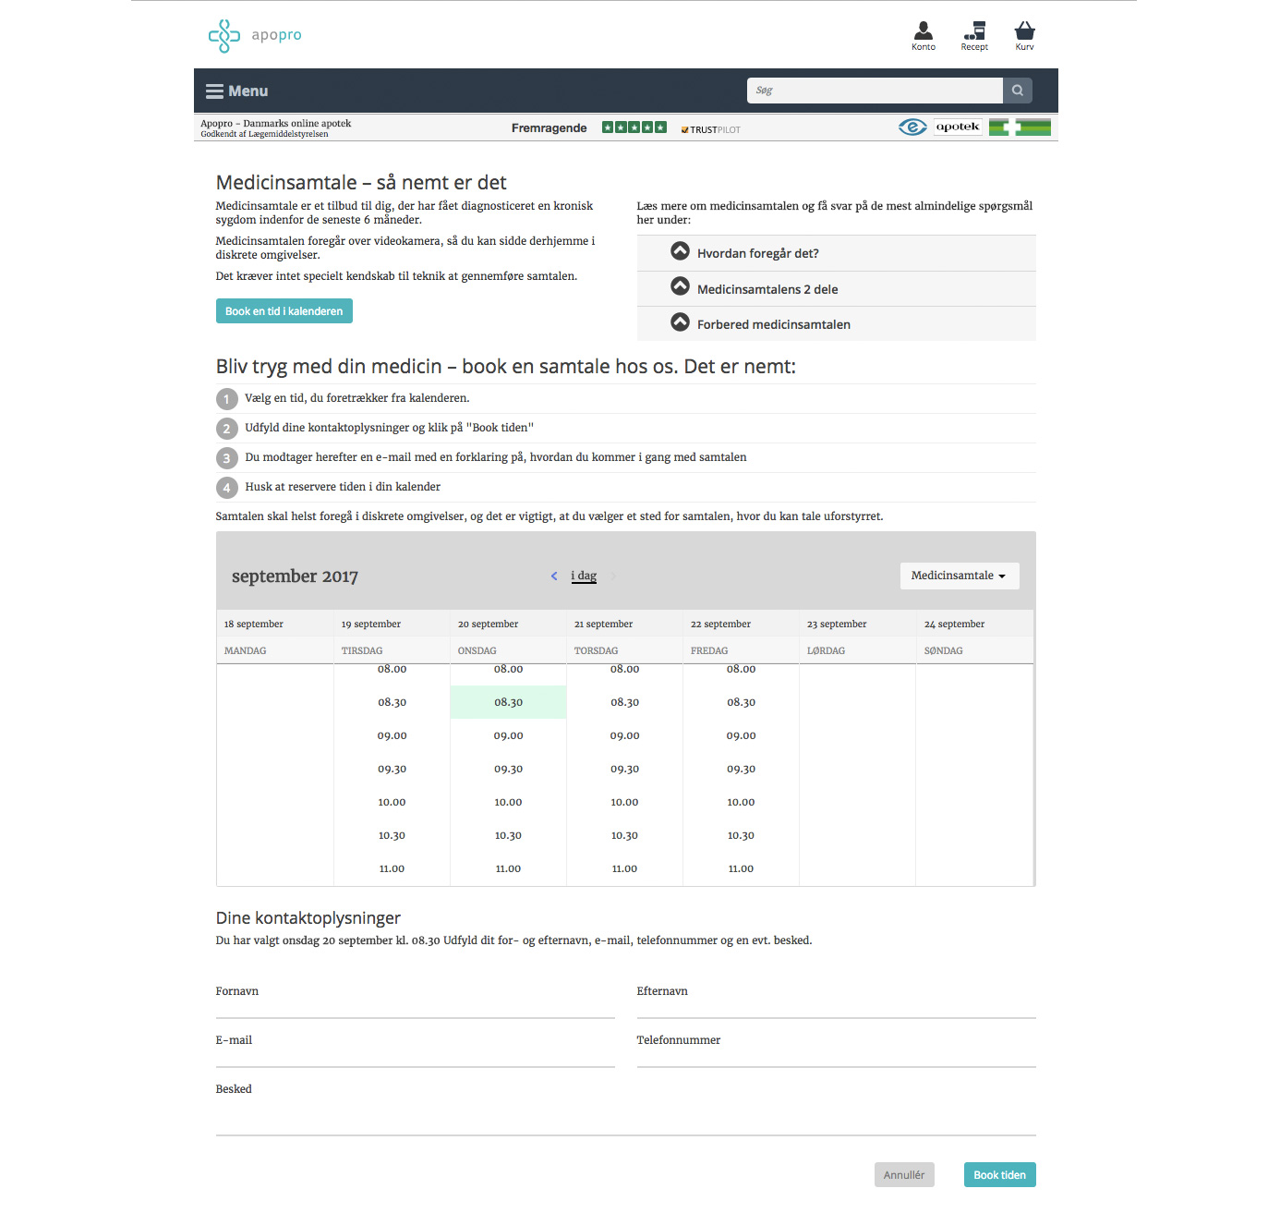
How does it work
A page or banner offers available timeslots to the visitor. The visitor selects a suitable time slot
A meeting link is sent to the visitor from where the visitor can join or cancel the meeting
At the time for the meeting
  The visitor clicks on the link and perform a online meeting with the agent or…
  The visitor gets a call from the service agent. The meeting can be conducted over the phone but also with a shared browser if needed (Phone to co-browsing)

Slide 5
Case
ApoPro
Medical customer support
Book a meeting with a pharmacist for medical advice
Make special competence available in a simple way
Usage of Vergi’s calendar module

Slide 6
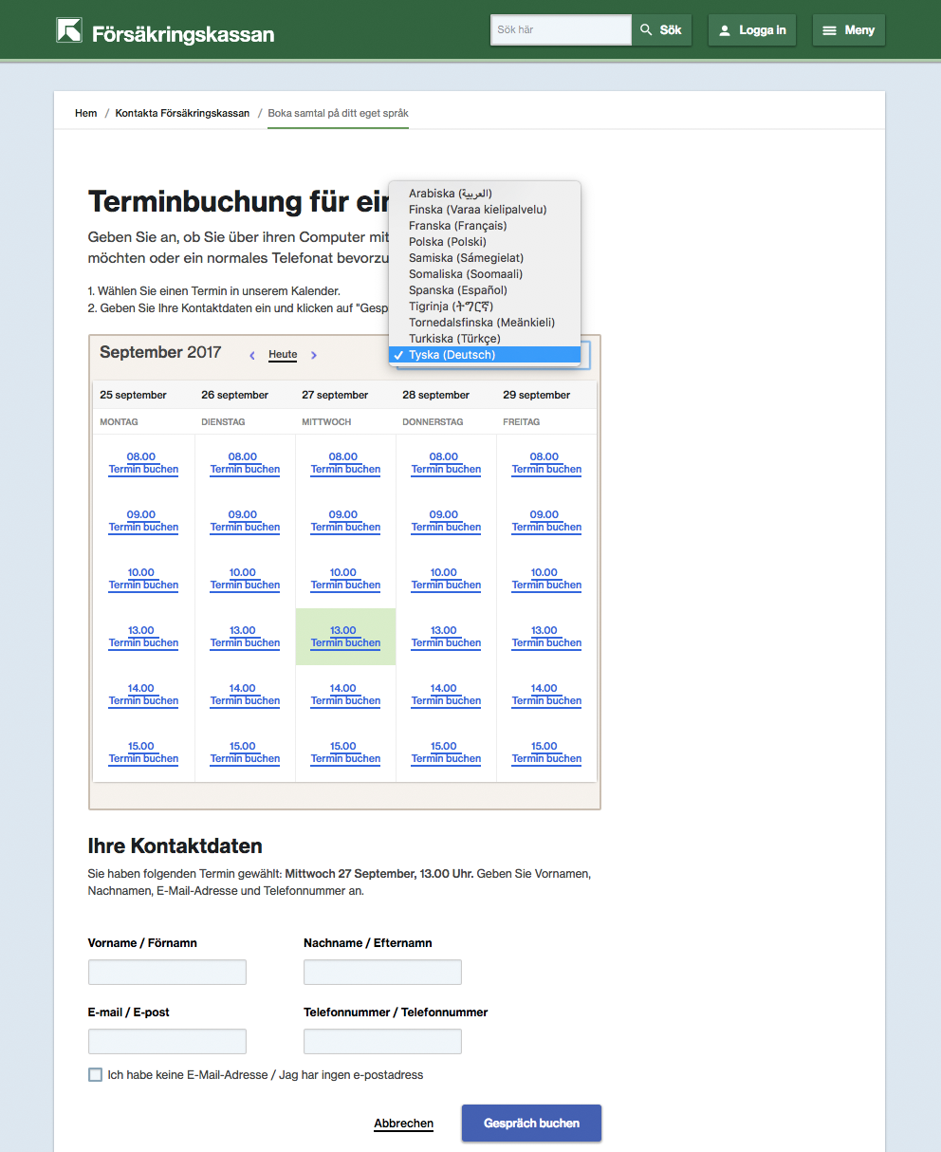
Case
Social Welfare institution
Digitalisation of complex processing – based on life situations or language barriers
Better availability and huge cost savings when going from personal physical meetings to personal digital meetings
Client, agent/expert and (in applicable cases) interpreter can be booked simultaneously
Usage of Vergic’s calendar module

Slide 7
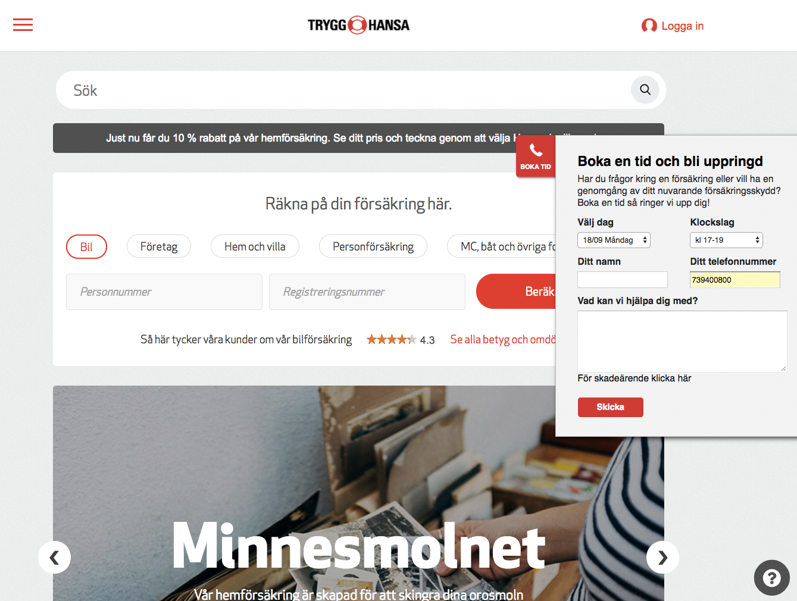
Case
Trygg hansa
Sales Focus, from a small test case to 500 booked digital sales meetings per week in just a month
Lead to a quick redisposition in the Marketing Plan – was in focus for TV-Campaigns during the initial months of 2017
Integrated part of different marketing campaigns
Meeting request is sent to external booking system

