Slide 1



Vergic Engagement technology overview
Confidential information
Notes:
WELCOME SLIDE

Slide 2












The largest Nordic companies are Vergic’s customers today
Government unit: Swedish Public Employment Service
Leading providers of insurance and pensions in the Nordic region
Leading retail companies
Government unit: Responsible for a large part of the public security systems in Sweden
Largest TV providers
Leading utility companies across EU
Government unit: Swedish Immigration services
Major telephone company and mobile network operator in the Nordics
Customer base characteristics
Largest government institutions
World leading retailers
World leading insurance / finance
Top Nordic TV providers
The majority of our customer are in the Nordic countries
A Few customers spread across EU and US
Notes:
JOHAN:
Key message
Vergic typical customer are examplyfied here
30 secs

Slide 3

Vergic Engage cloud service…
  Handles more than 100 million unique visitors handled each month
  75% of Swedish population 3 times per month
  Handles above one billion decisions per month about visitors in need of help – based on the algorithms and rules of the Vergic Engage platform
Notes:
It is a very transaction driven cloud service with very high load. We have built it to handle the major global companies like e.g H&M

Slide 4

Seamless between channels
Trends overview
Notes:
Seamless between channels – this is path – maybe thru interating
----- Meeting Notes (15-04-07 10:16) -----
-> Synch - rebtel

Slide 5
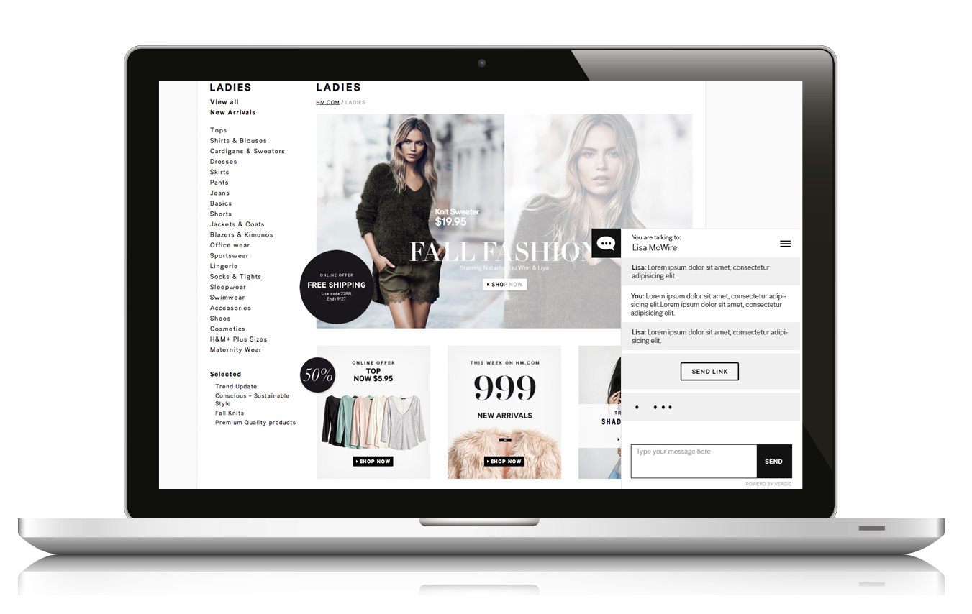
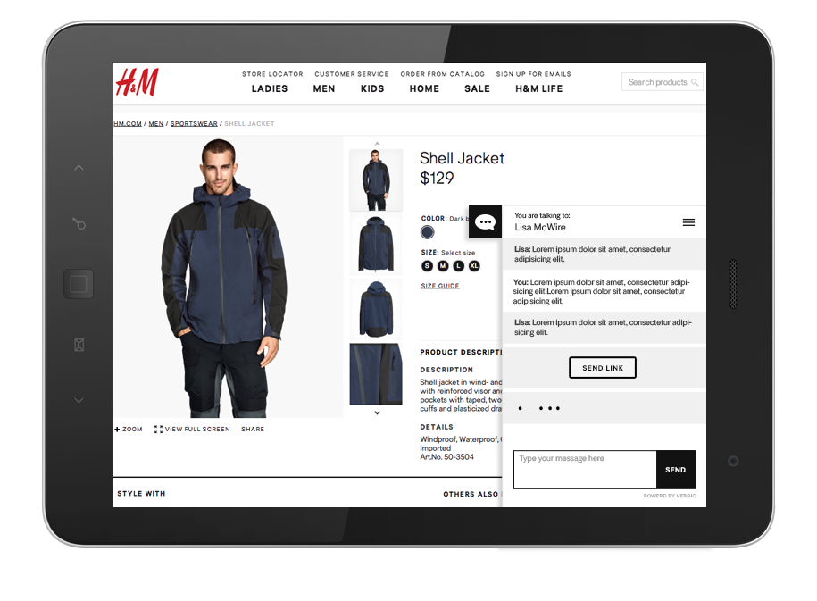
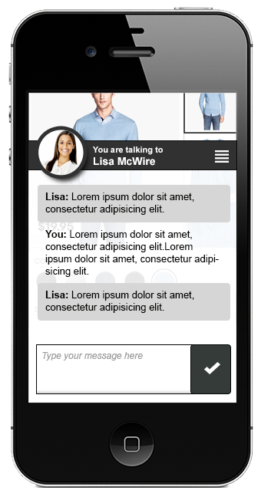
Support all devices, PC, Tablets, Smartphones with multiple dynamic sharing and co-browsing
An app integration library also exists for html5 based ios and android apps
Notes:
Consistency , easy to use, responsive, banners and chat experience is
Intelligence – right offer at the right time and place
Analytics
Open API for integration with 3 party applications/systems – BI, CRM, ERP
Seamless between channels - multified

Slide 6
Demo intro

Slide 7

A visitor enters a web page
Notes:
WELCOME SLIDE

Slide 8

Monitor
Profile
VEP
Platform
Analyzis
Personal Interaction
Notes:
WEB CRM – meets CONTACT CENTER WEB REALTIME ANALYTICS AND IN PROCESS COMMUNICATION

Slide 9
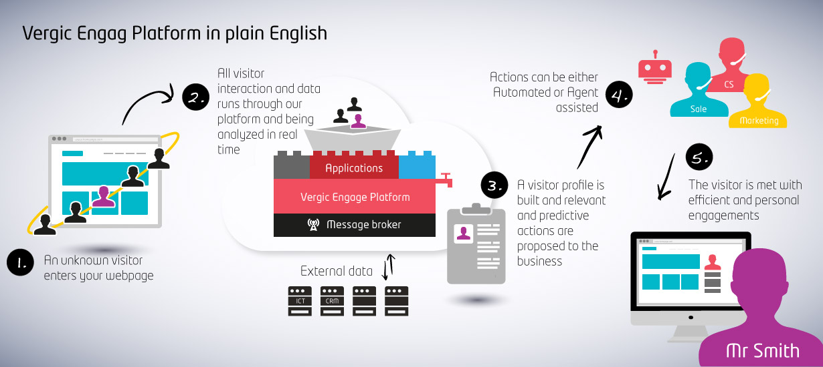
Proactive engagement engine overview

Slide 10
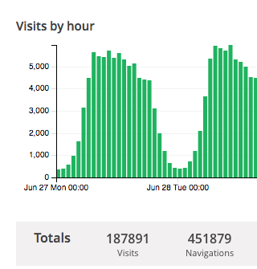
An anonymous visitor enters a web page
Monitor and profiling
Session id
Behaviour tracking initialized
Default algoritm
Predictive indentifition of confusion level

Slide 11
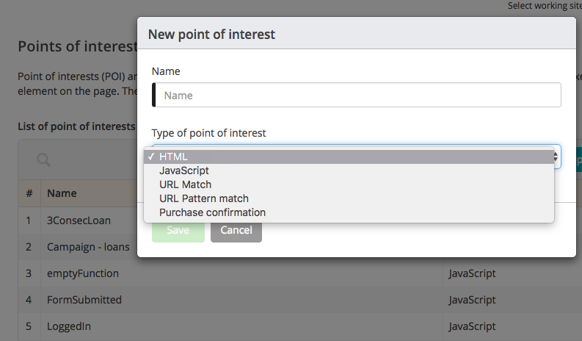
Add events and data to profile
Add web events, things that happen on page to the profile
Add external data
Examples:
  Cart value above $50
  Is Logged in
  Last purchase
  Customer lifecycle data
Adapt the default scoring system by combining known information to calculate interaction value in real time

Slide 12
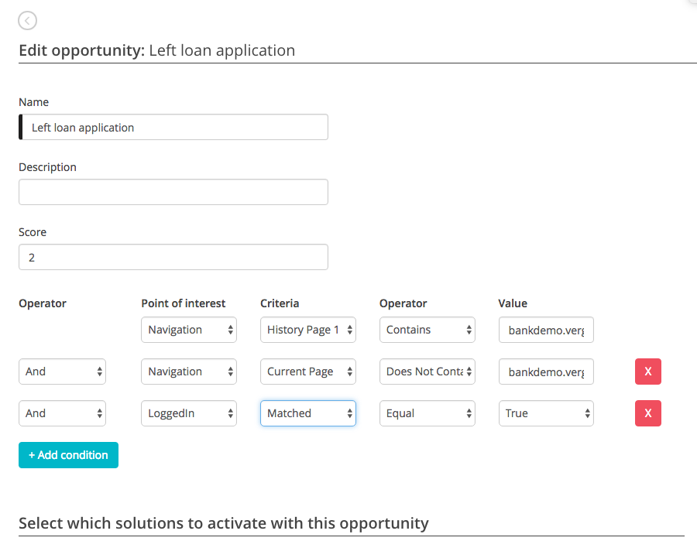
Identifiy communication opportunities
Use default scoring system
Mix your on processes
  Adapt the standard system to your own online processes and your own business model
Combine to identify opportunities to engage

Slide 13
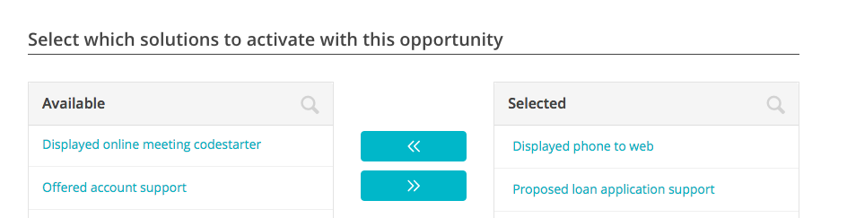
Act on these opportunities using solutions
Act by applying solutions to opportunities
  Automated
  Marketing
  Open communication channels – real time or async
You can even address the ones saying no
Map solutions to skills in you organisation and to capasity in real time

Slide 14
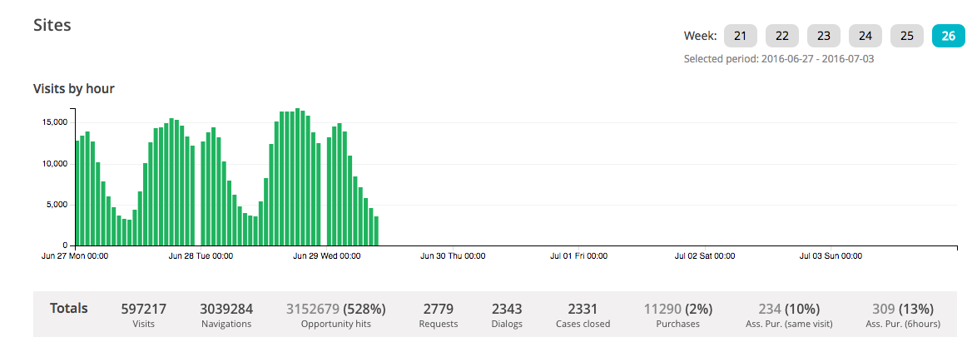
Measure effects
Measure how you are affecting goal conversion
Compare with the ones that do not engage

Slide 15
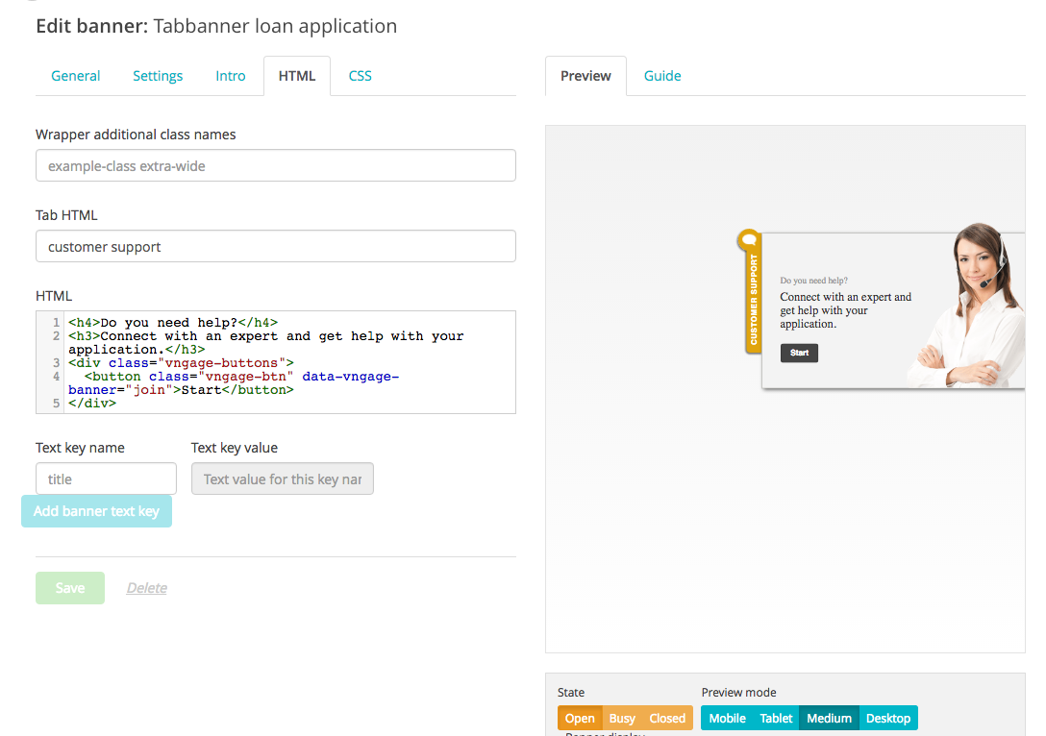
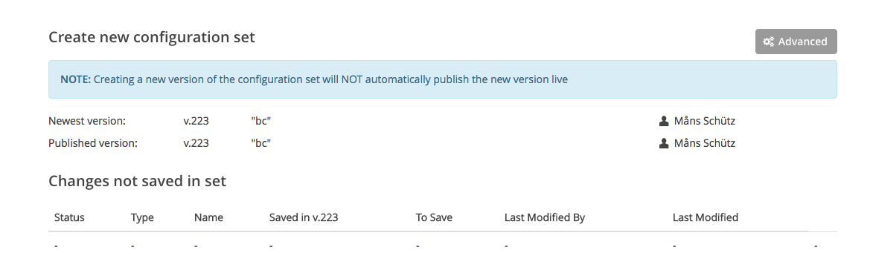
Adjust and improve any time
Make changes, test and launch

Slide 16
What will you see in this demo
An engagement module
A co-browse module initiated from an incoming phone call
A co-browse module initiate from a web site visitor
WEB RTC based video chat

Slide 17
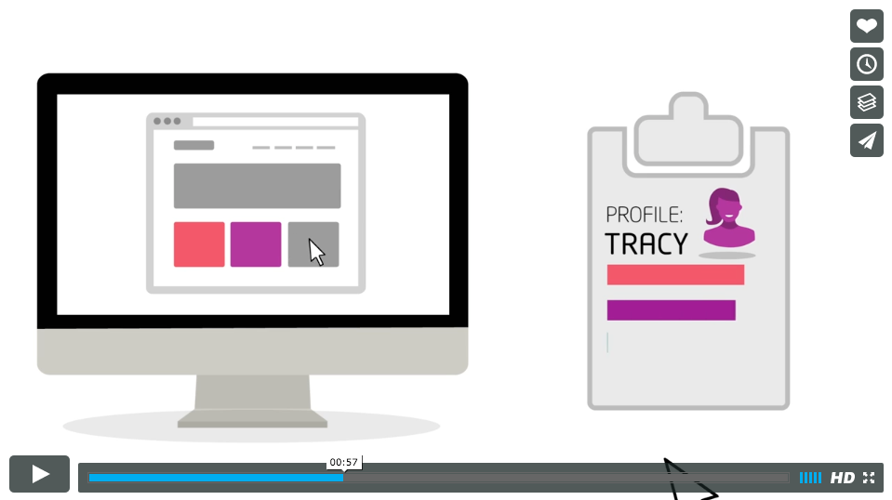
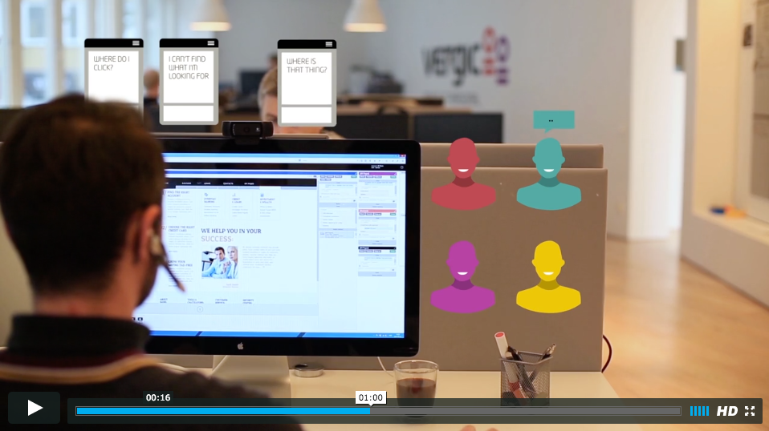
Learn Vergic in two minutes on Vimeo
Vergic concept video
https://vimeo.com/86502716
Product overview
https://vimeo.com/86502716
Notes:
In general this is what the Vergic Engage platform is all about
Increase conversion
Improve customer service
Have you seen our two videos? If not, let me show you a couple of videos

