Slide 1

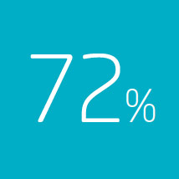
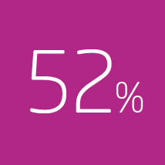
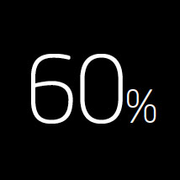

Houston, we have a problem
... of customers prefer using a organization website to answer their questions.
... but only 52% find the information they need online.
... of unanswered questions online leads to a phone call or e- mail.
But there is a solution :)

Slide 2
Vergic key market - what to focus on
Vergic Engage primary segments are:
  Public service / Government institutions
  Banking and financial services
  Telecommunications, B2C or large B2B operators
  E-commerce vendors or multi channel e-retailors
  Utilities & Energy
  In each of these segments Vergic has a market leaders as a customer already. Reference case material is available in needed
Vergic Engage Enterprise is designed for web sites with more than 250 000 monthly visits
Vergic Engage Chat and Chat + is designed for sites with more than 100 000 monthly visits
Vergic Engage primary focus is B2C companies selling complex products or providing complex services
Vergic Engage is design for companies were the web site is an important part of their business. The web site should contain sales or support processes, where visitors can sign up or perform self service operations

Slide 3

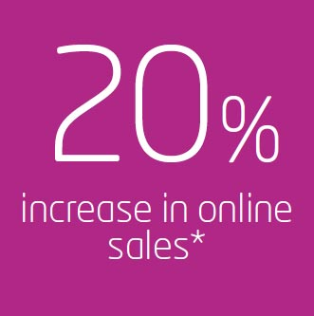
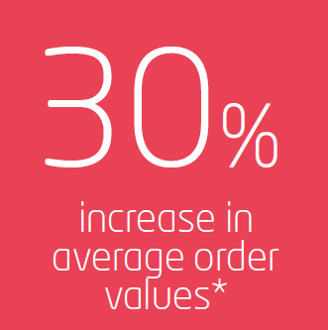
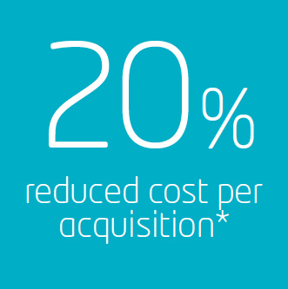
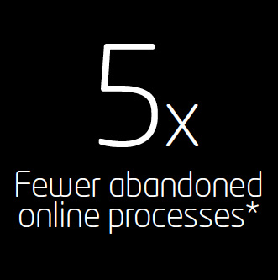
Sales & Marketing
Boost your online sale
Vergic Engage Platform powers
personalized real-time online
customer engagements
*Forrester
Notes:
Sales and marketing

Slide 4

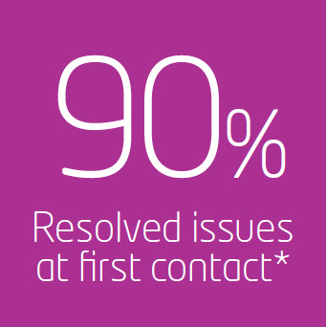
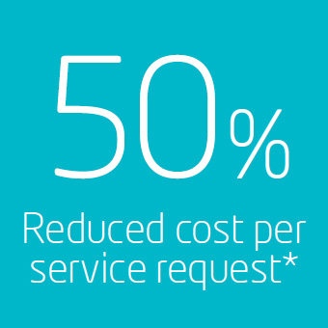
Customer support
Customer support
Vergic Engage Platform powers
personalized real-time online
customer engagements
*Forrester

Slide 5

Public sector
Cost efficient and citizen-centric engagements that matters
Digital inclusion: Vergic Engage Platform powers personalized real-time online customer engagements
Source: Forrester

Slide 6
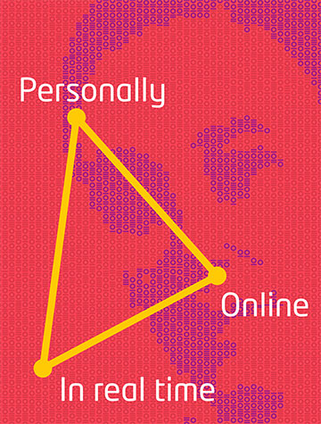
Effects of Vergic explained
Targeted customer support
  Vergic finds the right visitors to engage with at the right point in time, when the visitors is in need of help. This is fully automated in the Enterprise variant of Vergic Engage
  By efficiently empower the agent with relevant information and an instant visual representation of the visitors situation for the agent the contextual parts of the chat dialog is efficiently removed. This will greatly enhanced the customer experience and enhance agent efficiency

Slide 7
Effects of Vergic explained
Replacing a standard pop-out/on page chat with Vergic normally reduces handling times for agents by 50%, they become more effective
Vergic increases the number of chats by up to 100% compared to classic reactive or proactive solution, avoiding unnecessary non value add chats and greatly reducing the number of incoming emails
Customer experience score are increased by 50% because of the enhanced customer experience
These figures has been proved time and time again through existing market leading customers within our key segments

Slide 8
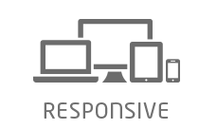




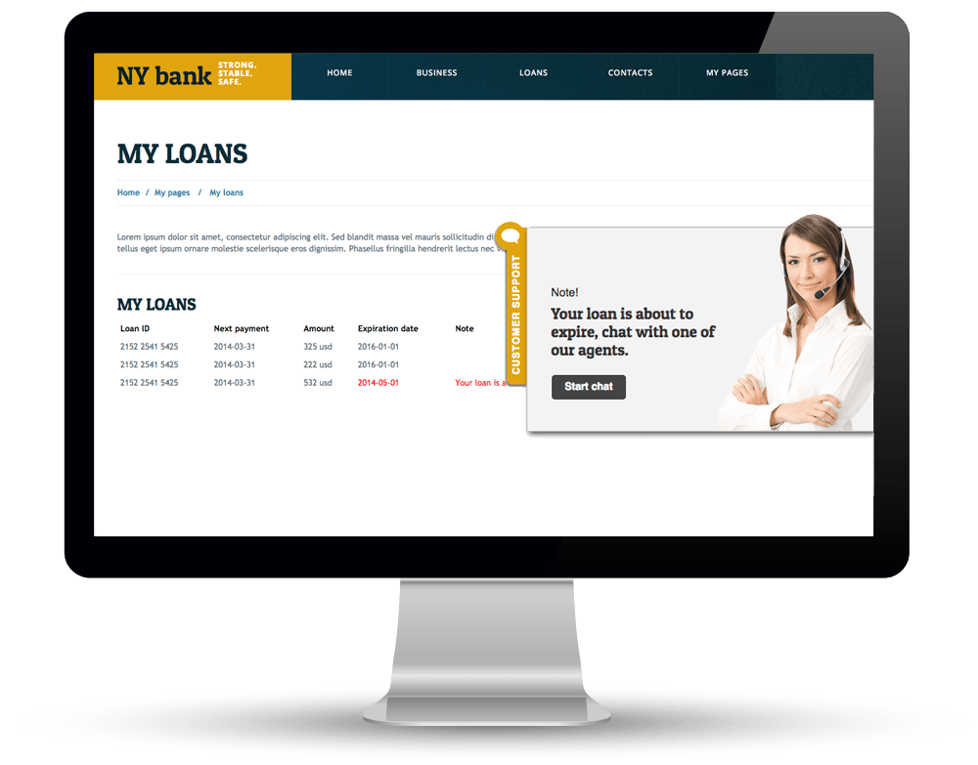


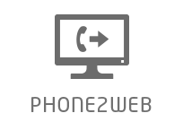




Notes:
Poängtera att kanalen är On-line. Vengage kombinerar kanalen on-line med valfri kontaktkanal – Öka läsbarhet

Slide 9
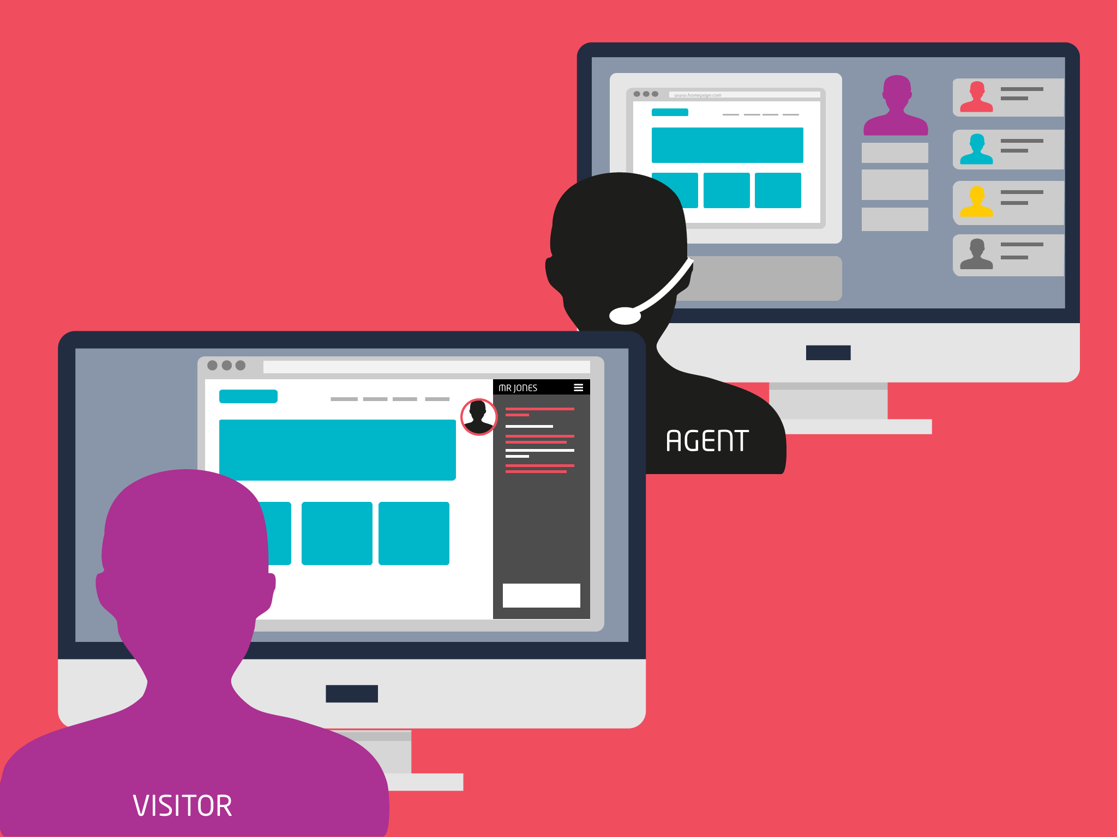
Phone2web
Co-Browse
Guide the visitor
Fill in forms
Share documents

Slide 10
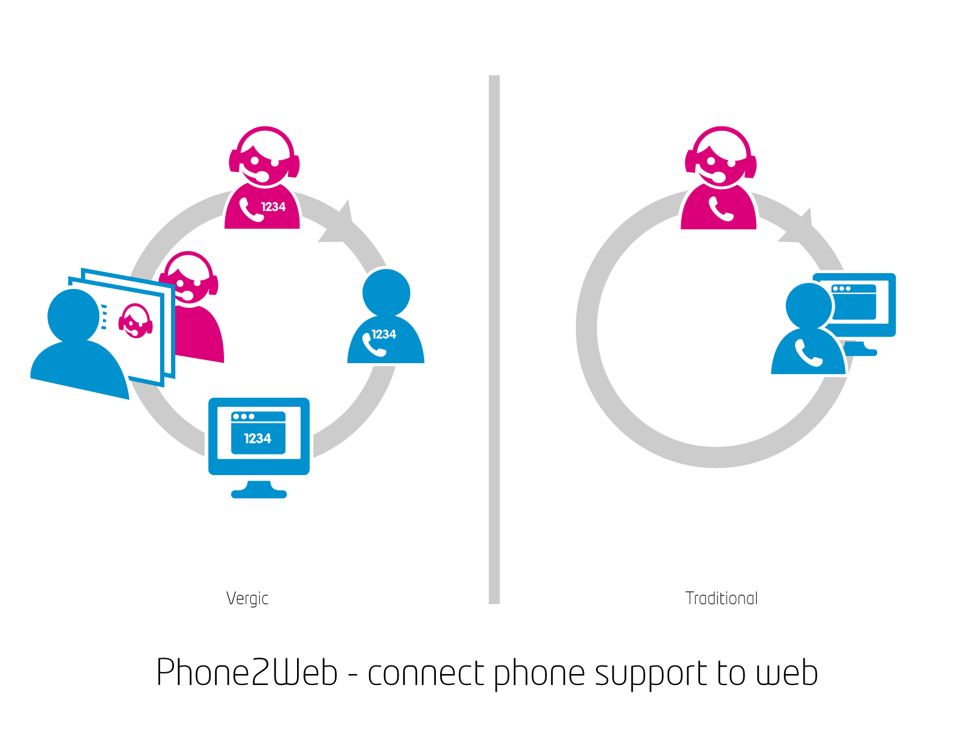

Slide 11
Why choose Vergic – a brief USP introduction​
If you are just looking for a chat​
The plain chat market is crowded with vendors offering simple pop-out, on in page text based chat tools. Vergic Engage Chat product comes with an advanced chat that has an integrated co-browse tool and audio/video chat capabilities, providing the agent with an instant view of the visitors situation and challenges enhancing customer experience and reducing chat. No pop-out and embeddable into any web page by adding a line of java script. With these features added to the stack, the competitors are reduced to a few, if any?​
If you need to see that your visitors are doing / World class co-browse​
Vergic contains an integrated co-browse feature. No installation is required. The co-browse tool works in any device and with screen size. You can use initiate the co-browse tool from an invite on page or from an incoming phone call by providing a pin code. Vergic co-browse is not a regular co-browse were you have to initiate a mutual browsing session between the agent and the visitor. Vergic world leading technology enables agents to instantly jump into an on-going web process session, such as a bank loan application or a web shop purchase already started. In this area Vergic is unique in the global market​
If you are managing a team​
Vergic Engage contains the tools you need to get a real time view on how your team and website is performing. Vergic contains tools to monitor team performance across multiple skill groups/teams, languages and websites. Adding these features to the stack further reduces the competitors​
If Customer experience / Customer engagement is important to you​
Several players in the market offers customer engagement technology. Vergic technology is the most advanced and the most cost efficient to implement in the market today. Vergic analyses real time site behaviour, and you can easily add adapt Vergic to your business model using advanced multi step rules with no programming skills required. Vergic Engage Enterprise enables you to instantly use external data such as digital ID login, CRM data, ERP data to enhance the engagement system. Vergic are doing advance behaviour analytics for world leading e-retailors supporting millions of monthly visitors. Giving each of these visitors real time engagements, personalized to each visitors individual needs and challenges, even when there is no agent available. In this are Vergic is the most advanced toolset available in the market today.​
In total Vergic is the most advanced combination of Customer Experience, Co-browse, Chat tool in the market today and you can use Vergic with any contact centre software available in the market today, and any web site tool you might have just by adding a java script tag to your web site​

