Slide 2

Partner
Program Guide
Overview
This overview is to assist you in understanding the opportunities, program components, and investment that will help you take full advantage of the Vergic Partner Program.

Slide 3
1
Overview

Slide 4

Value
Differentiate from the competition with a unique web communication platform
New opportunities to new customers or existing customers by offering the best-in-class technology and integrated solutions.
Grow your existing accounts
Increase your revenue and profitability
Win new business

Slide 5



Three partner levels
Vergic Platinum partner – Fully engaged partner. The highest partner level which gives you the most of your investment into Vergic.
Vergic Gold partner – Partly engaged partner. The second partner level which allows you to take part of some deliveries combined with licensing
Vergic Silver partner – Licensing partner where Vergic takes care of all implementations.

Slide 6
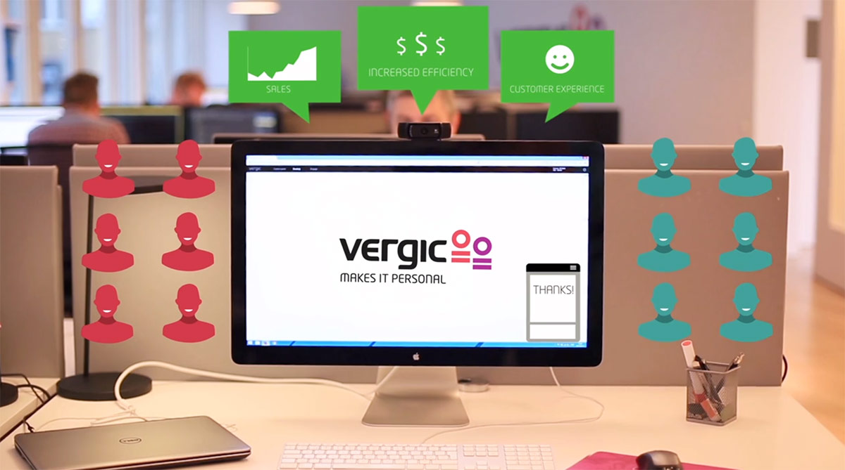
Products
As a partner you have access to sell Vergics latest technology including hardware, software, and services.
Discounts
Discounts are based on partner level and commitments to the partner program. It is designed to provide you with revenue growth and profitability.

Slide 7

Marketing plan
Joint marketing efforts is key to develop and increase awareness and new opportunities
Business plan
A business plan is jointly developed and focuses in delivering success to both parties.

Slide 8
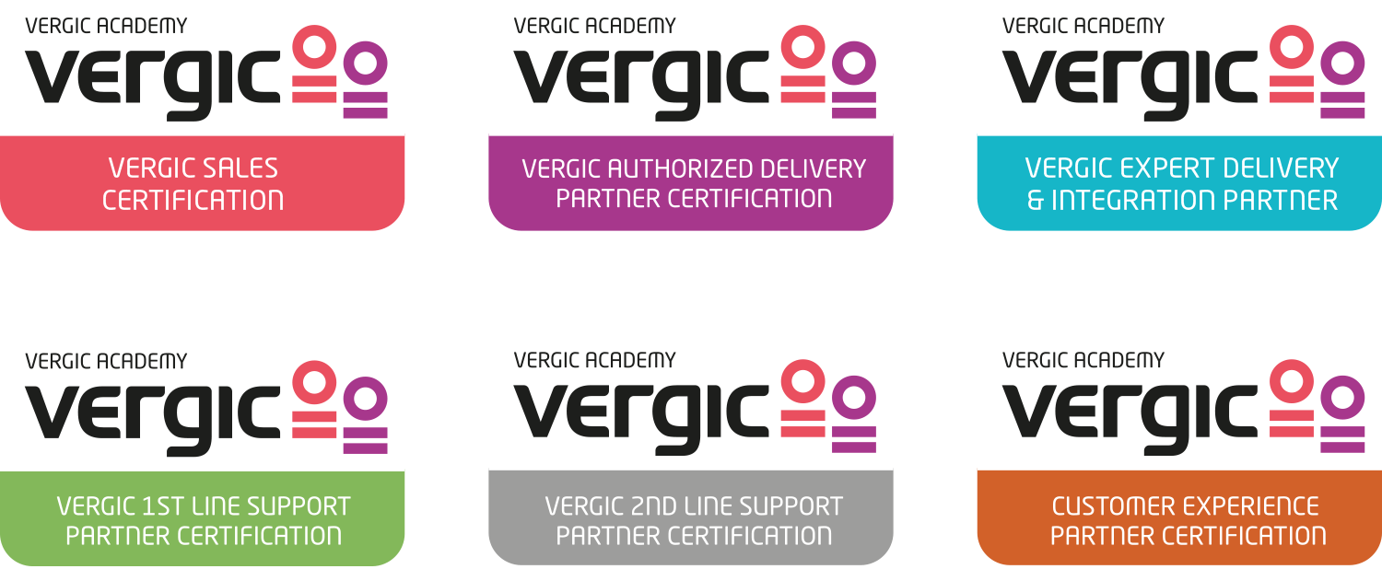
Vergic Academy
To make sure your organization is equipped to take on challenges and to be able to deliver customer satisfaction we have developed Vergic Academy on different levels to ensure quality engagement.

Slide 9
2
Program details

Slide 10
Program Requirements
To maintain partner status, you must meet all the program requirements at your partner level.
 | Platinum | Gold | Silver
Annual Sales Volume (Licenses) | 500 K € | 200 K € | 50 K €
Signed reseller agreement | Yes | Yes | Yes
Sales persons | 5 | 3 | 1
Solutions Engineer | 2 | 1 | -
1st line Support | Yes | Yes | Vergic
2nd line Support | Yes | Vergic | Vergic
Customer Experience | Yes | Yes | Vergic
Delivery | Yes | Parts | Vergic
Demo account | Yes, tailormade | Yes | Yes
Website | Yes | Yes | Yes
Vergic Engage on website (Purchase required) | Yes | Yes | -
Forecasting | Yes | Yes | -
Business plan | Required | Required | Recommended
Marketing plan | Required | Recommended
Discount level | 1 | 2 | 3
Customer contract owner | Yes | Yes | Vergic

Slide 11

Partner level amendment
Vergic preserves the right to adjust the partner level if the requirements aren’t met fully within thirty (30) days notice.
Reseller contract
All Partners despite partner level to Vergic are required to sign a reseller/partner contract. After that you can begin taking advantage of the program benefits.

Slide 12

Business plan
Vergic Platinum and Vergic Gold partners are required to submit a business plan that includes the marketing, sales, and support goals. The business plan will be reviewed quarterly to improve the business development. We also encourage Vergic Basic partners to build a business plan.
Marketing plan
Joint marketing efforts is key to develop and increase awareness and new opportunities.

Slide 13


Vergic Academy

Slide 14
Pre-sales/support/Customer Experience training & Certification
Vergic Platinum , Vergic Gold and Vergic Silver partners are required to take trainings and certifications. To maintain partner status at your program level, partners must meet the pre-sales certification requirements. Training will be held onsite on regular bases and upon requirement. There will be different levels of pre-sales trainings and certifications following the partner level which reflects the partner program.
 | Platinum | Gold | Silver
Vergic Sales | Yes (5) | Yes (3) | Yes (1)
Vergic Authorized delivery partner | Yes (2) | Yes (1) | -
Vergic Expert delivery & Integration partner | Yes (2) | - | -
Vergic 1st line Support partner | Yes | Yes | -
Vergic 2nd line Support partner | Yes | - | -
Customer Experience Partner | Yes (1) | Yes (1) | -
1

Slide 15
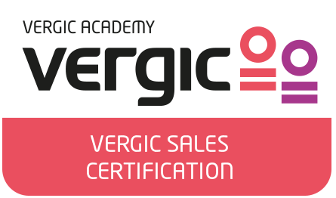
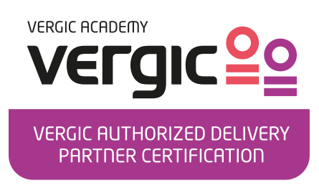
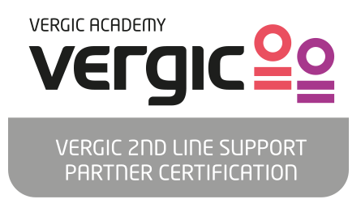
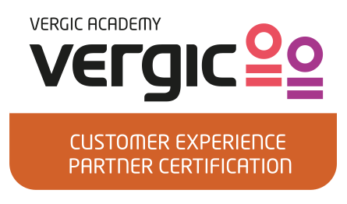
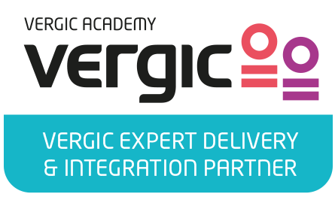
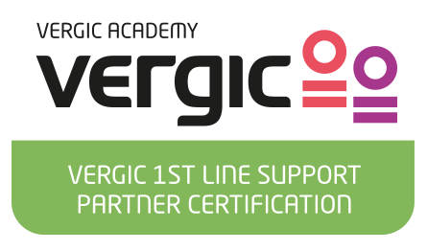
All certifications are valid from one (1) year from date of certification and are required to refresh their program certifications prior to their certification expiration date.
The accurate number of certifications must be maintained at the selected program level. If you do not have the accurate number of certifications, you will lose your partner status. The partner must replace lost certifications within sixty (60) days in the event the certified individual leaves their employ.
Certifications are based upon individual performance and remain with the individual.
2

Slide 16

Sales training & Certification
All partners are required to take sales trainings and certifications. To maintain partner status at your program level, partners must meet the sales certification requirements. Training will be held onsite on regular bases and upon requirement. Certifications are based upon individual performance and remain with the individual.

Slide 17
Vergic Authorized delivery partner
VADP builds on the first step of delivery for Cloud based solutions and dedicated hosting solutions. It gives you an in-depth understanding of the product line.
Vergic Expert delivery & Integration partner
VEDIP requires VADP certification and is the second step of delivery for Cloud based solutions and dedicated hosting solutions. It gives you an in-depth understanding of rolling out a complete delivery including integrations.

Slide 18
Vergic 1st line support partner
Vergic 1st line support partner certification is the first step of engaging with the end customer. It requires phone support 8-17 local time and requires that you as a partner can solve easy errands. Access and ability to work in Vergic support system, Youtrack.
Vergic 2nd line support partner
Vergic 2nd line support partner certification is the second step of engaging with the end customer. It requires phone support 8-17 local time and requires that you as a partner can solve easy errands and also go in-depth to resolve customer satisfaction. 247 support is recommended. Access and ability to work in Vergic support system, Youtrack is included.

Slide 19

Vergic Customer Experience partner
Vergic Customer Experience partner certification is how you as a partner engage the customer when working with the Vergic solutions. The certification allows you to educate customers and makes sure you as a partner together with the customer gets the most out of the solution.

Slide 20
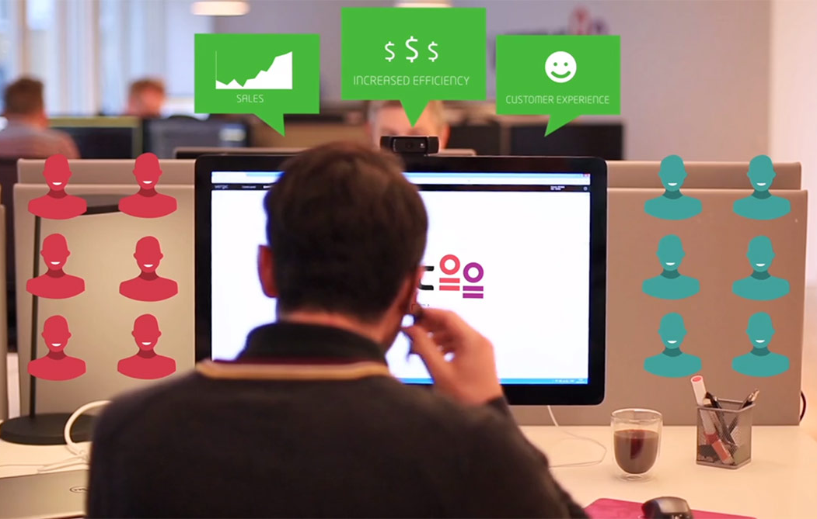
Demo account
Vergic Partners are given access to Vergic demo accounts. Partners should use them according to the training program and the instructions therein. Demo accounts are effective throughout the partner status is valid.

Slide 21

Forecasting
Vergic Platinum and Vergic Gold partners are required to supply a 90-day non-binding forecast to Vergic monthly. The forecast is used to assist Vergic and the partners to improve our joint commitments and to evaluate the strategic business development.

Slide 22
Discounts
Discounts are based on partner level and commitments to the partner program. It applies for hardware, software and services based on your program level.
Sales support
The Vergic sales team are available to assist with business and marketing plans, training, proposals, joint meetings and order processing.

Slide 23
Pre-sales support
Vergic pre-sales engineers within the local region provide pre-sales support for partners.
Partner council
Vergic Platinum partners are eligible to join the Vergic Partner Council. Partner council will be held once a year. Vergic Gold partners will have the opportunity to join by invitation only

Slide 24

Vergic Partner Portal
All partners are given access to the Vergic Partner portal. The portal gives you access to a wide range of tools:
Vergic Knowledgebase
Campaign
Feature request
Marketing material
Product Documentation
Release Notes
Pricelist

Slide 25
End user data
The partner must agree to supply end user data directly to Vergic for all systems that the partner has sold to end users.
Having correct and effective data on the location and type of solution that have been sold is critical to proper service delivery.
Partners are required to provide Vergic with the sales out data for all services programs.
Vergic preserves the right to refuse services without end user data.

