Slide 2



Welcome to Vergic Sales

Slide 3
Phase 1
Need Analysis

Slide 4
Why is it so important to ask the correct questions
“Take the time to diagnose before you offer a prescription”

Slide 5
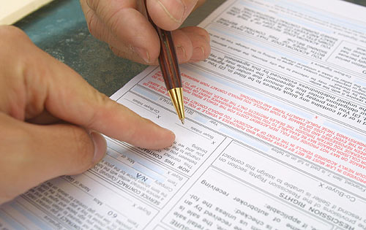
WHY PEOPLE
BUY

Slide 6


Get Rid of
PAIN
Increase
PLEASURE

Slide 7
Needs analysis Should be seen as a separate meeting from the demo
Notes:
The risk your facing mixing needs analysis and demo is that you wont be able to find the explicit needs to build the case on. Better to round of and show the 2 Vergic movies and then schedule a full demo!

Slide 8
Interest Matrix – Always prepare in advance
Top menu item | Top menu item | Top menu item
Who?
On the site
Purpose?
Challenges
Goals

Slide 9
On-line web processes and challenges
Example
Web Shop | Customer Service | stores
Existing customer or potential customer | Normally an existing customer | Existing (?) customer in Elisa store
Usually un authenticated visitor(?) | Sometimes (preferably) an authenticated visitor | Sometimes (preferably) an authenticated visitor
Seeking information and/or buy products/services | Seeking answers and/or trying to solve a problem | Seeking answers and/or trying to solve a problem
Keep visitor in buying process, if existing customer – get customer to authenticate at an early stage | Increase self service, get customer to authenticate (my pages). “Push” incident to preferred channel | Get customer to self serve through in store kiosk, “smooth” transition from sales agent to CS online
Ensure conversion, increase order value and cross sell. Deliver a good shopping experience | Ensure a good customer experience, streamline processing and lower operational cost | Ensure a good customer experience, free sales agent time in store
Who?
On the site
Purpose?
Challenges
Goals
Notes:
Let the interest matrix Stay on the screen when asking questions and use it as support to your discussion

